Slide 1
St. Louis Central Corridor West Building Permits
Quarter 1 Report: 2020

Slide 2
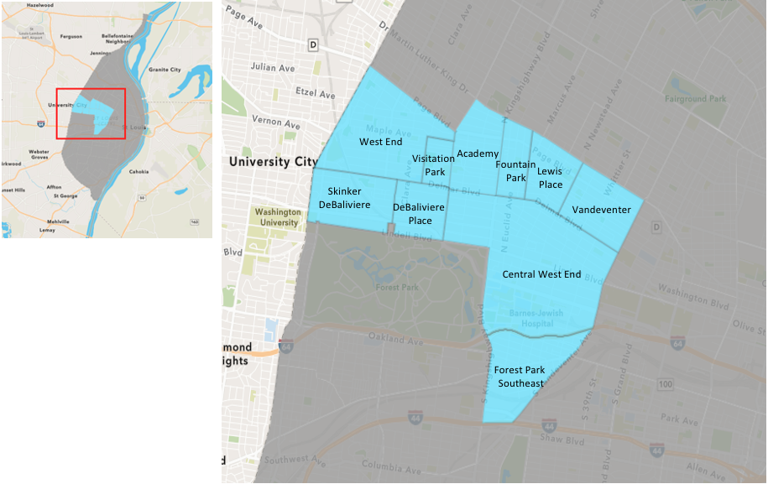
St. Louis Neighborhood Spatial Reference

Slide 3
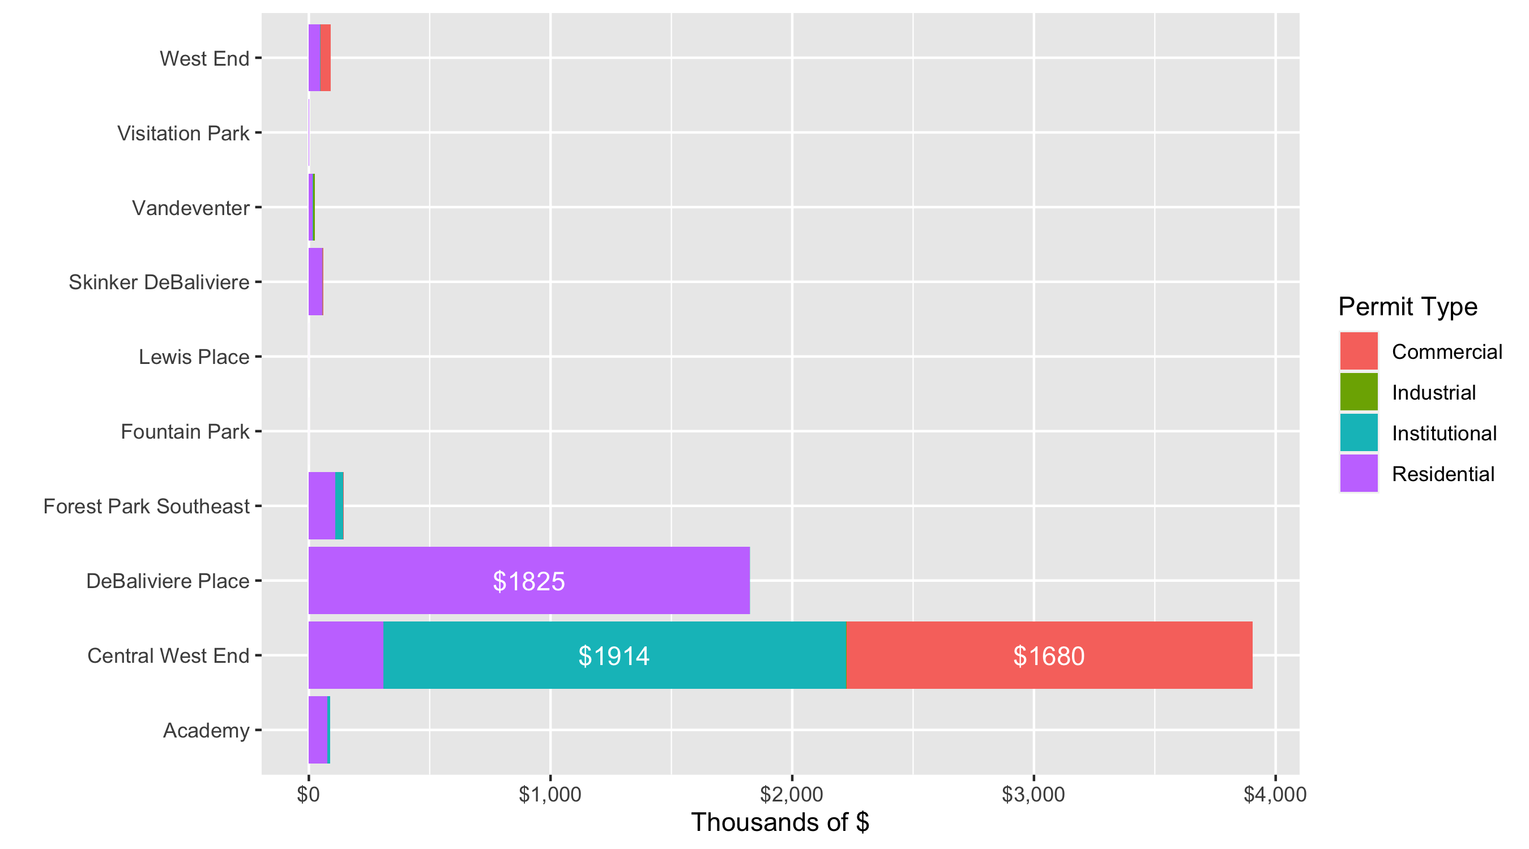
Neighborhood Summary: Total Building Permit Cost

Slide 4
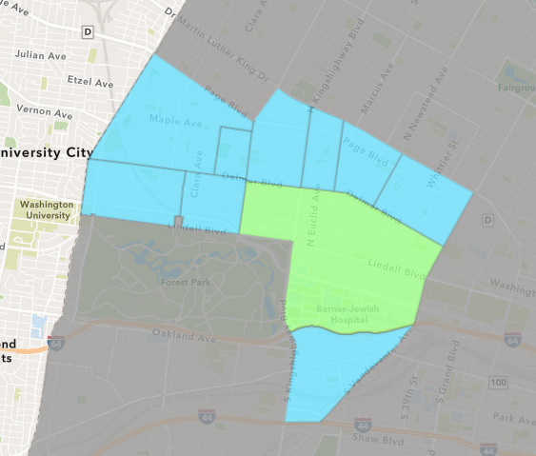
Central West End
Quarter 1 , 2020 Neighborhood Cost Breakdown
Sum of Permits: $39,034,514
Mean: $358,115
Median: $21,676
Range: $250 - $16,000,000

Slide 5
Central West End: Summary Notes
109 building permits in Quarter 1, 2020
-11.38% change compared to Quarter 1, 2019 (123 total building permits)
$358,115: Average building permit cost in Quarter 1, 2020
87.47% change compared to Quarter 1, 2019 ($191,028)

Slide 6
Central West End: Summary Notes
54 residential permits in Quarter 1, 2020
20.00% change compared to Quarter 1, 2019 (45 total building permits)
$57,077: Average residential building permit cost in Quarter 1, 2020
53.24% change compared to Quarter 1, 2019 ($37,247)
1 industrial permits in Quarter 1, 2020
Infinite change compared to Quarter 1, 2019 (0 total building permits)
$21,676: Average industrial building permit cost in Quarter 1, 2020
Infinite change compared to Quarter 1, 2019 ($0)

Slide 7
Central West End: Summary Notes
15 commercial permits in Quarter 1, 2020
-37.50% change compared to Quarter 1, 2019 (24 total building permits)
$1,120,197: Average commercial building permit cost in Quarter 1, 2020
974.79% change compared to Quarter 1, 2019 ($104,225)
40 residential permits in Quarter 1, 2020
-25.93% change compared to Quarter 1, 2019 (54 total building permits)
$478,568: Average institutional building permit cost in Quarter 1, 2020
33.77% change compared to Quarter 1, 2019 ($0)

Slide 8
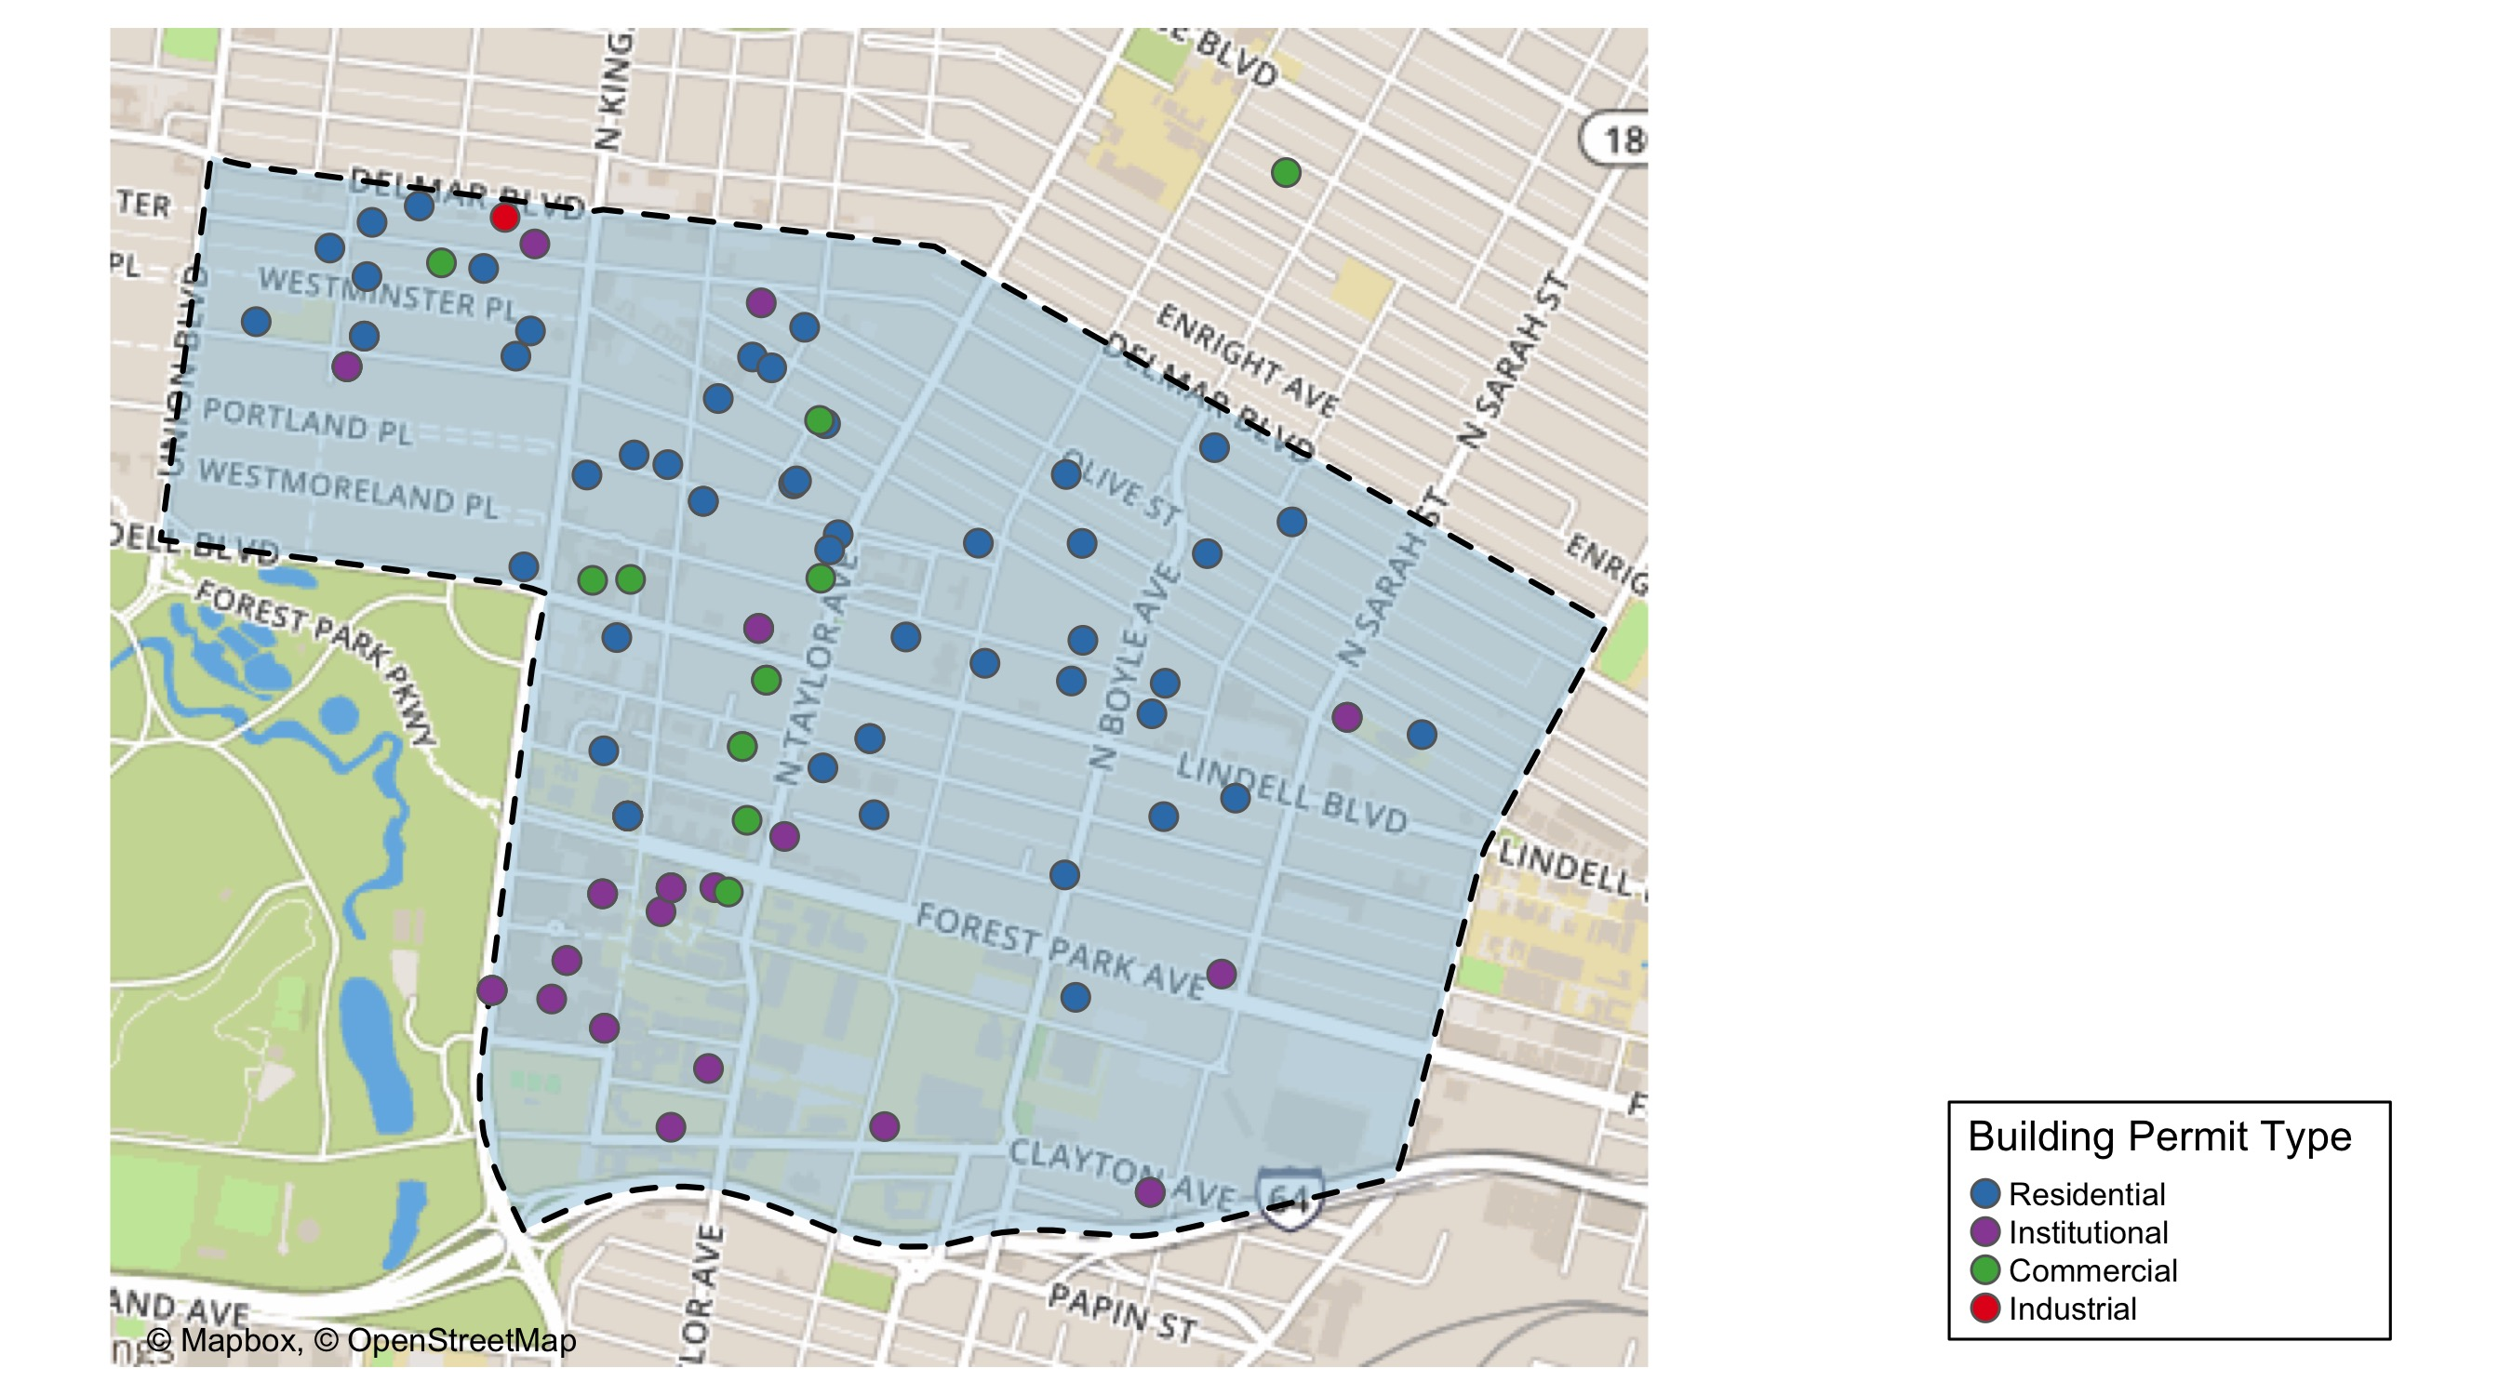
Central West End

Slide 9
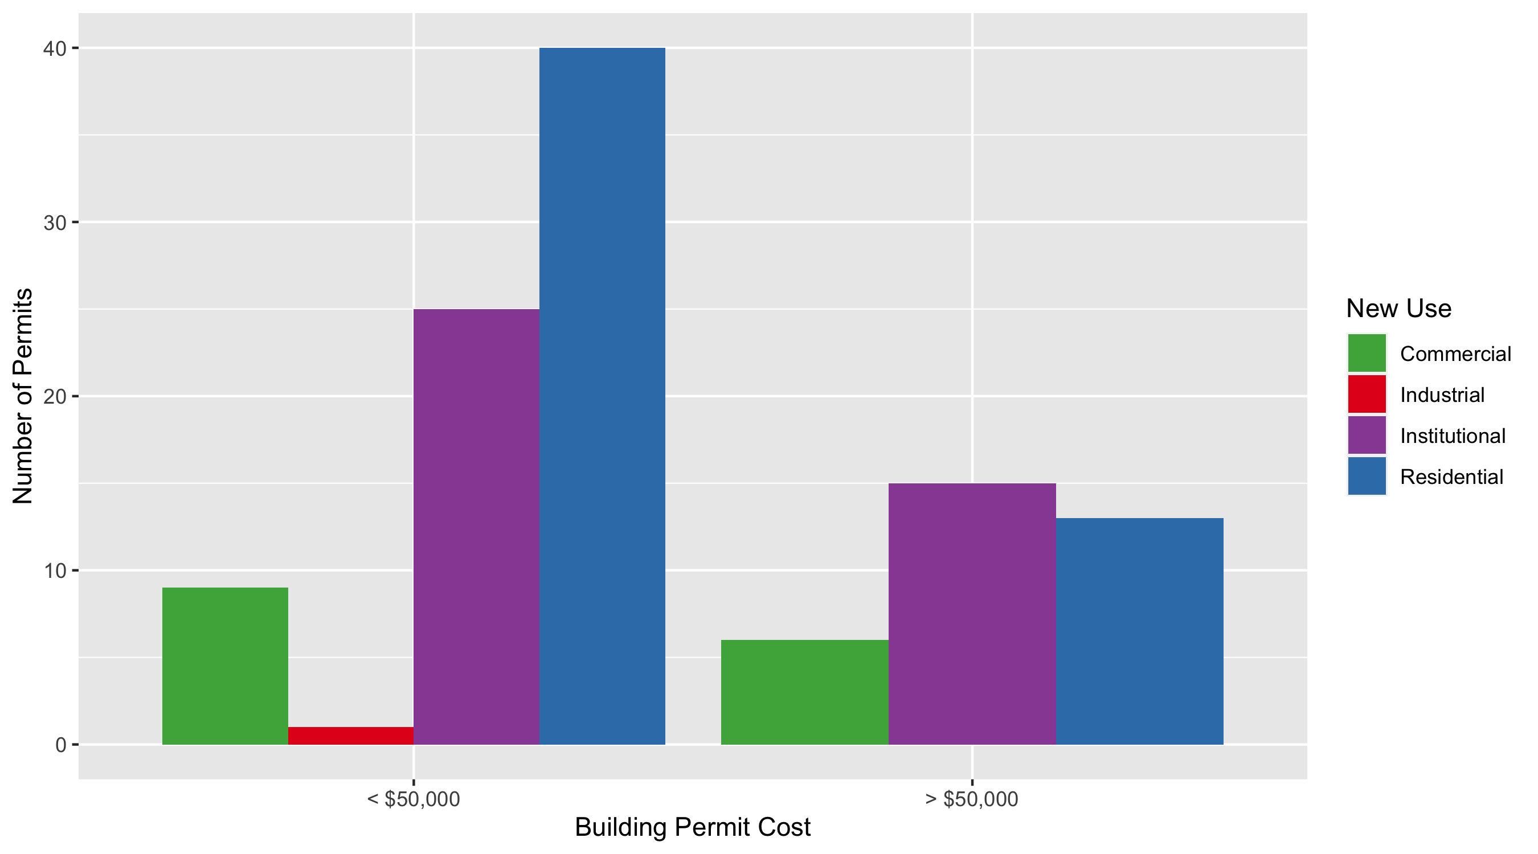
Central West End Permit Use Breakdown

Slide 10
Central West End Permit Breakdown
Quarter 1, 2020 | Quarter 1, 2020 | Quarter 1, 2020 | Quarter 1, 2020
Permit Use | Average Cost | # of Permits | Total Value of Permits
Commercial | $1,120,197 | 15 | $16,802,948
Industrial | $21,676 | 1 | $21,676
Institutional | $478,568 | 40 | $19,142,737
Residential | $57,871 | 53 | $3,067,153
Total | $1,678,312 | 109 | $39,034,514
Quarter 1, 2019 | Quarter 1, 2019 | Quarter 1, 2019 | Quarter 1, 2019
Permit Use | Average Cost | # of Permits | Total Value of Permits
Commercial | $104,225 | 24 | $2,501,401
Industrial | $0 | 0 | $0
Institutional | $357,757 | 54 | $19,318,874
Residential | $37,247 | 45 | $1,676,124
Total | $499,229 | 123 | $23,496,399

Slide 11
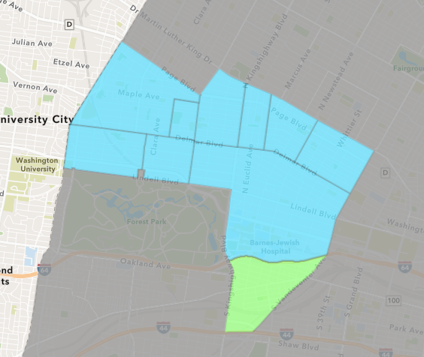
Forest Park Southeast
Quarter 1 , 2020 Neighborhood Cost Breakdown
Sum of Permits: $948,129
Mean: $47,406
Median: $8,400
Range: $50 - $264,094

Slide 12
Forest Park Southeast: Summary Notes
20 building permits in Quarter 1, 2020
-61.54% change compared to Quarter 1, 2019 (52 total building permits)
$47,406: Average building permit cost in Quarter 1, 2020
-75.04% change compared to Quarter 1, 2019 ($189,950)

Slide 13
Forest Park Southeast: Summary Notes
16 residential permits in Quarter 1, 2020
-51.52% change compared to Quarter 1, 2019 (33 total building permits)
$67,749: Average residential building permit cost in Quarter 1, 2020
-45.96% change compared to Quarter 1, 2019 ($125,358)
0 industrial permits in Quarter 1, 2020
-100.00% change compared to Quarter 1, 2019 (2 total building permits)
$0: Average industrial building permit cost in Quarter 1, 2020
-100.00% change compared to Quarter 1, 2019 ($13,500)

Slide 14
Forest Park Southeast: Summary Notes
4 commercial permits in Quarter 1, 2020
-66.67% change compared to Quarter 1, 2019 (12 total building permits)
$10,225: Average commercial building permit cost in Quarter 1, 2020
-93.40% change compared to Quarter 1, 2019 ($154,888)
2 residential permits in Quarter 1, 2020
-60.00% change compared to Quarter 1, 2019 (5 total building permits)
$164,120: Average institutional building permit cost in Quarter 1, 2020
-78.71% change compared to Quarter 1, 2019 ($13,500)

Slide 15
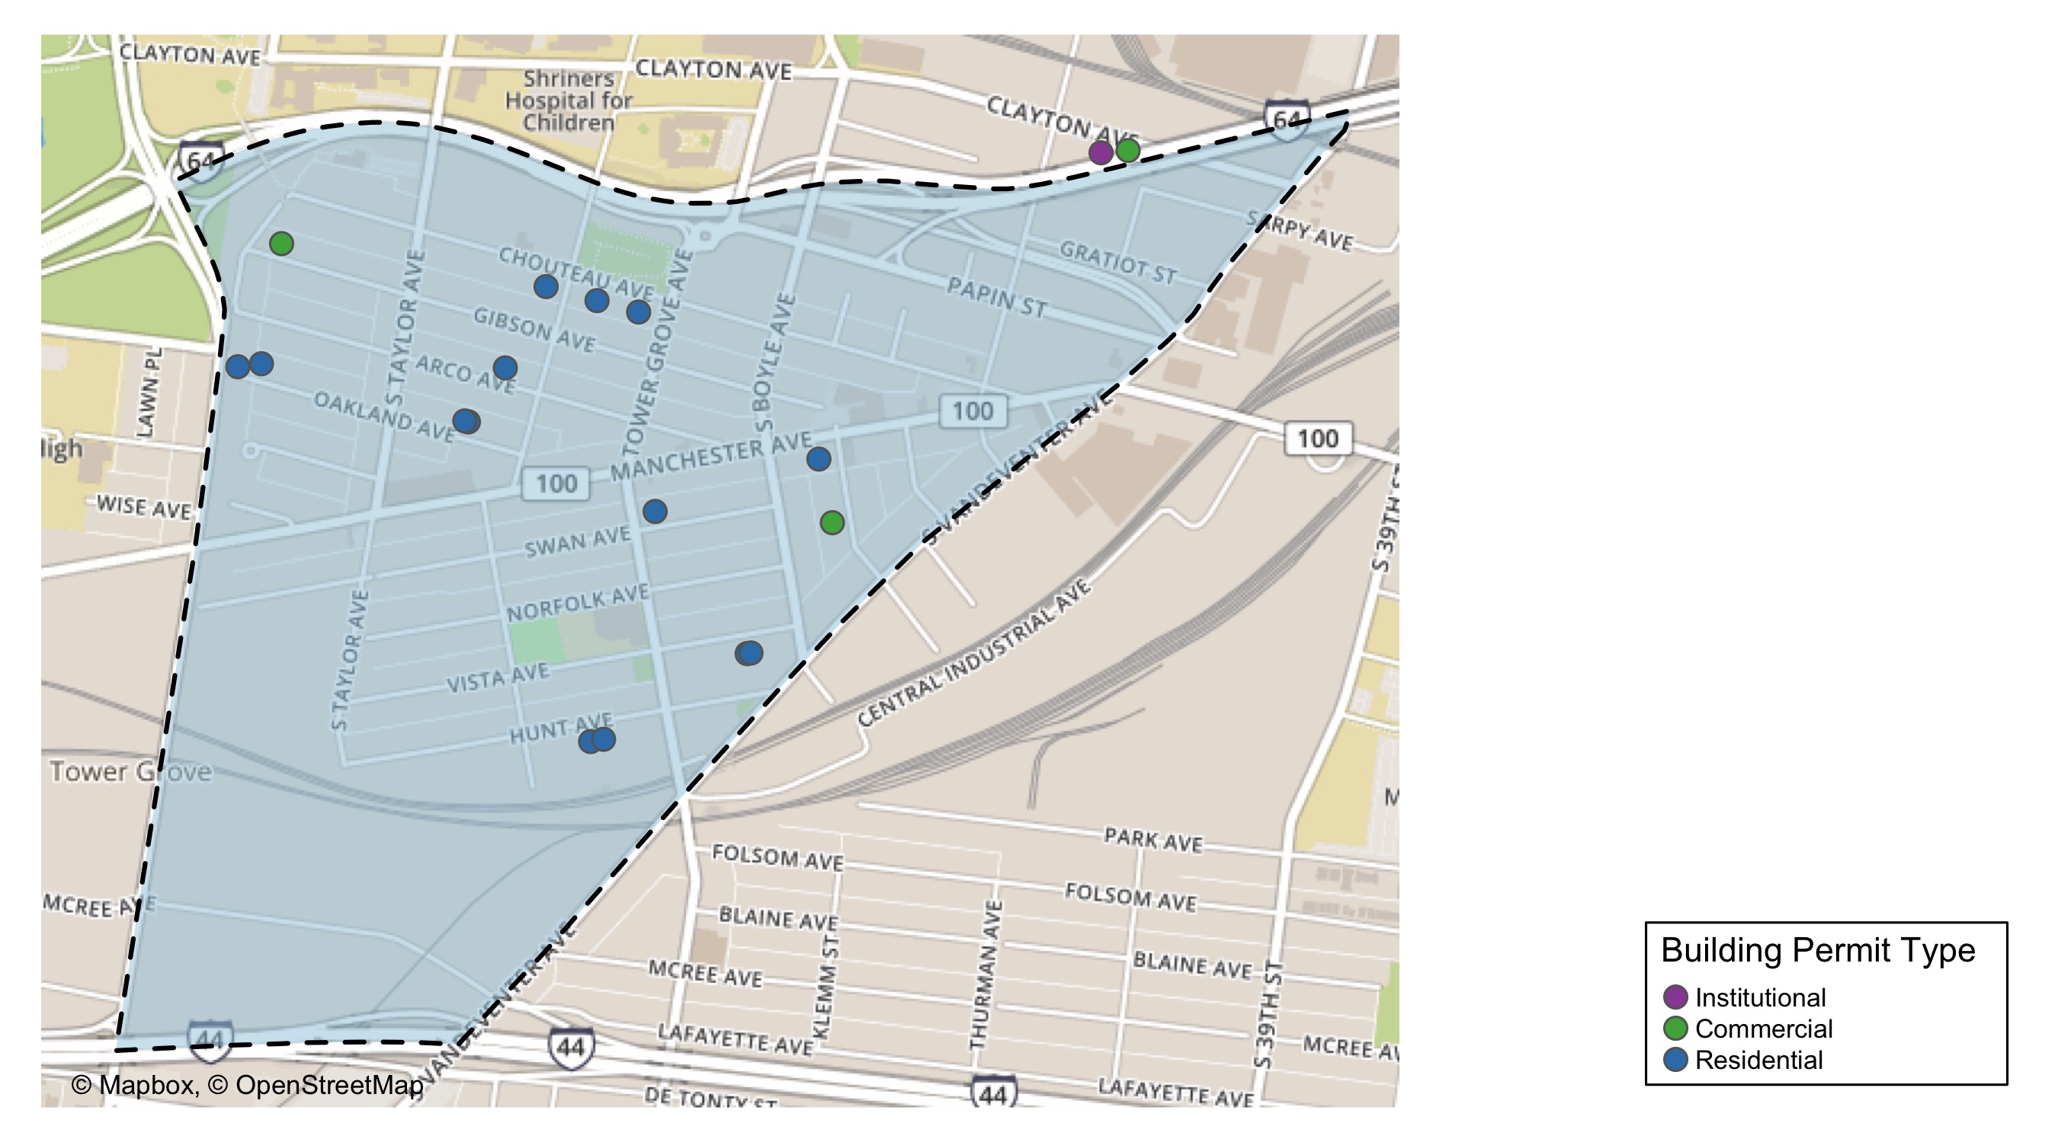
Forest Park Southeast

Slide 16
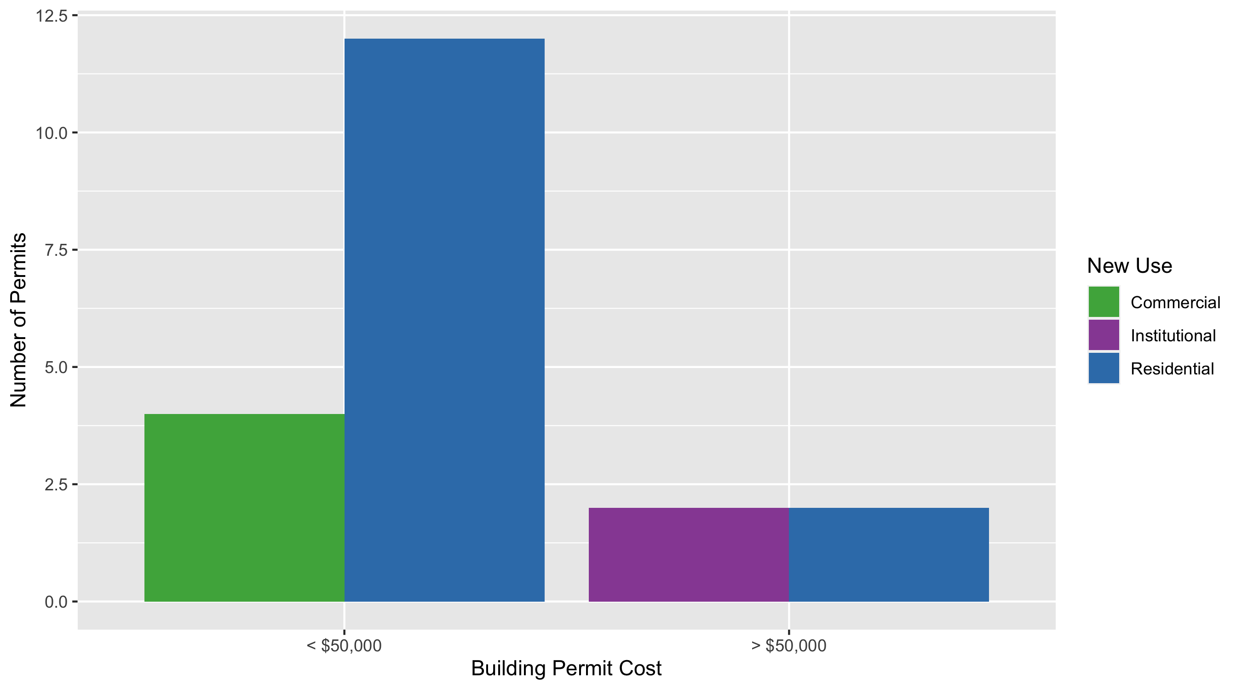
Forest Park Southeast Permit Use Breakdown

Slide 17
Forest Park Southeast Permit Breakdown
Quarter 1, 2020 | Quarter 1, 2020 | Quarter 1, 2020 | Quarter 1, 2020
Permit Use | Average Cost | # of Permits | Total Value of Permits
Commercial | $10,225 | 4 | $40,900
Industrial | $0 | 0 | $0
Institutional | $164,120 | 2 | $328,239
Residential | $41,356 | 14 | $578,990
Total | $215,701 | 20 | $948,129
Quarter 1, 2019 | Quarter 1, 2019 | Quarter 1, 2019 | Quarter 1, 2019
Permit Use | Average Cost | # of Permits | Total Value of Permits
Commercial | $154,888 | 12 | $1,858,651
Industrial | $13,500 | 2 | $27,000
Institutional | $770,986 | 5 | $3,854,929
Residential | $125,358 | 33 | $4,136,805
Total | $1,064,731 | 52 | $9,877,385

Slide 18
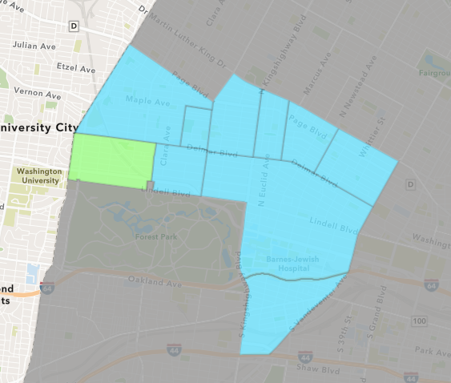
Skinker DeBaliviere
Quarter 1 , 2020 Neighborhood Cost Breakdown
Sum of Permits: $611,743
Mean: $17,478
Median: $8,450
Range: $150 - $150,000

Slide 19
Skinker DeBaliviere: Summary Notes
35 building permits in Quarter 1, 2020
105.88% change compared to Quarter 1, 2019 (17 total building permits)
$17,478: Average building permit cost in Quarter 1, 2020
-6.30% change compared to Quarter 1, 2019 ($18,653)

Slide 20
Skinker DeBaliviere: Summary Notes
30 residential permits in Quarter 1, 2020
87.50% change compared to Quarter 1, 2019 (16 total building permits)
$18,429: Average residential building permit cost in Quarter 1, 2020
19.33% change compared to Quarter 1, 2019 ($15,444)
0 industrial permits in Quarter 1, 2020
0.00% change compared to Quarter 1, 2019 (0 total building permits)
$0: Average industrial building permit cost in Quarter 1, 2020
0.00% change compared to Quarter 1, 2019 ($0)

Slide 21
Skinker DeBaliviere: Summary Notes
4 commercial permits in Quarter 1, 2020
Infinite change compared to Quarter 1, 2019 (0 total building permits)
$12,219: Average commercial building permit cost in Quarter 1, 2020
Infinite change compared to Quarter 1, 2019 ($0)
1 residential permits in Quarter 1, 2020
0.00% change compared to Quarter 1, 2019 (1 total building permits)
$10,000: Average institutional building permit cost in Quarter 1, 2020
-85.71% change compared to Quarter 1, 2019 ($0)

Slide 22
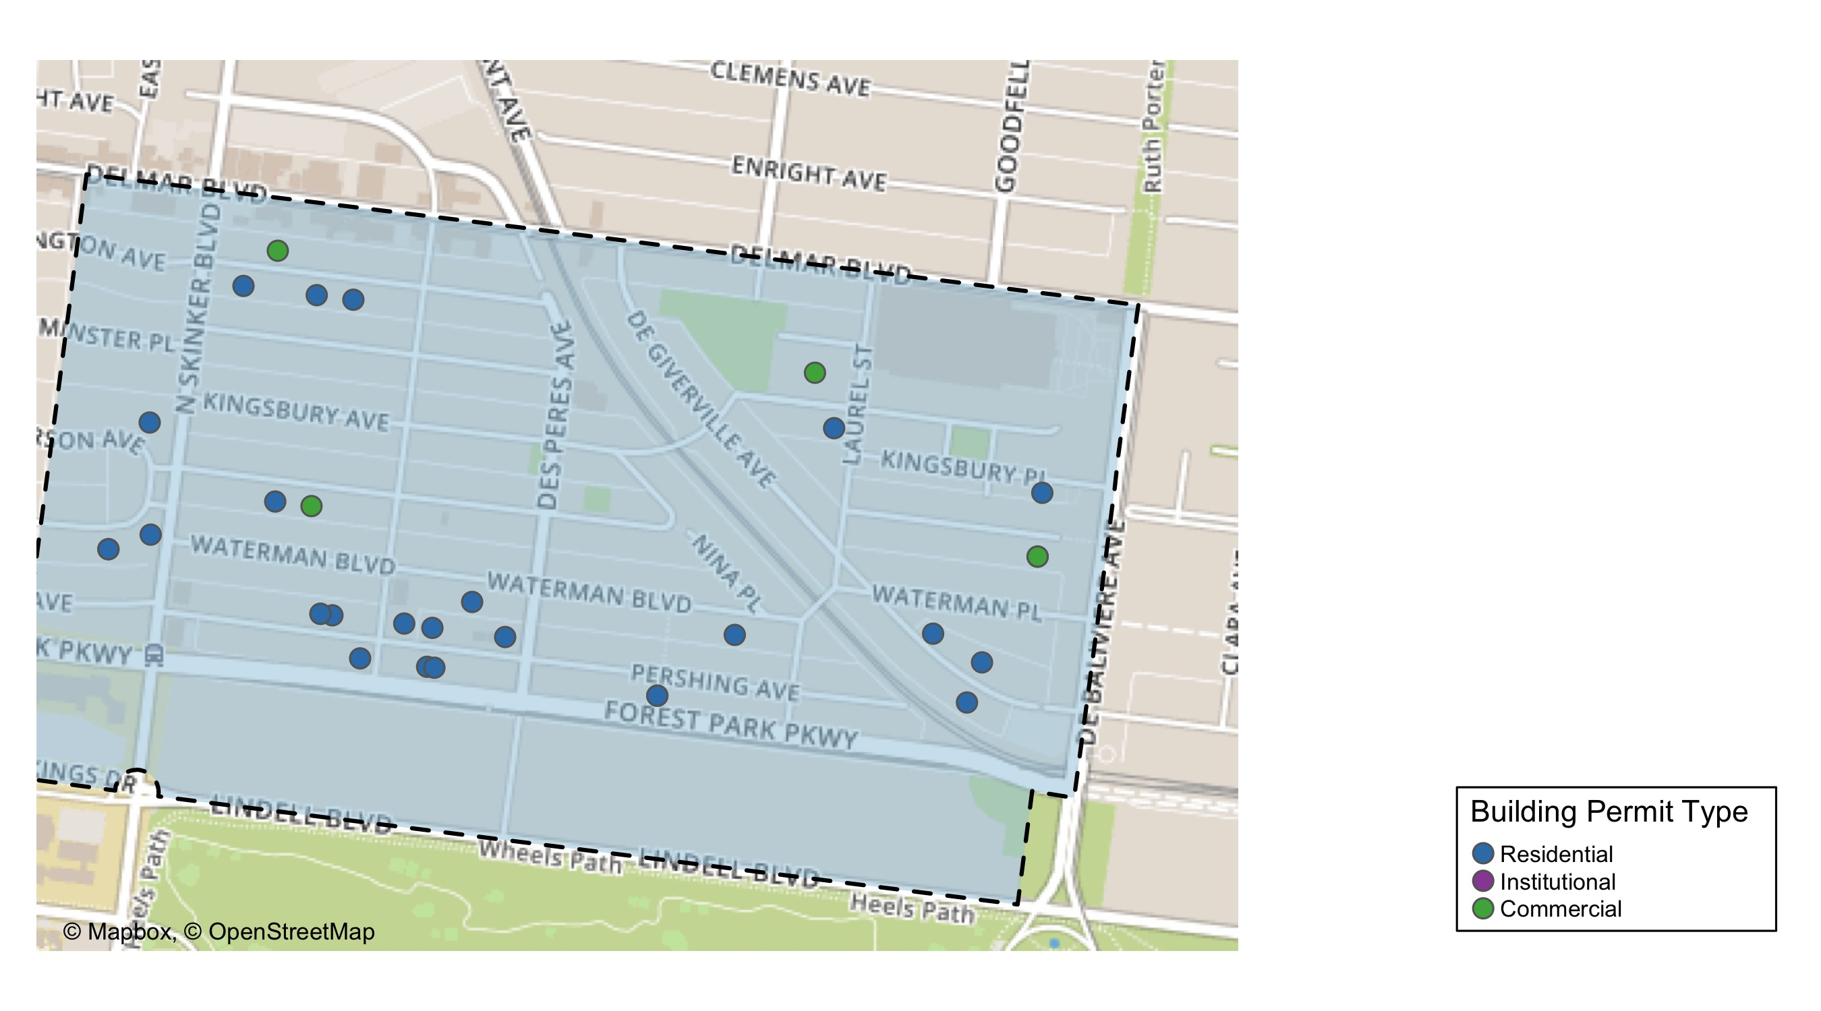
Skinker DeBaliviere

Slide 23
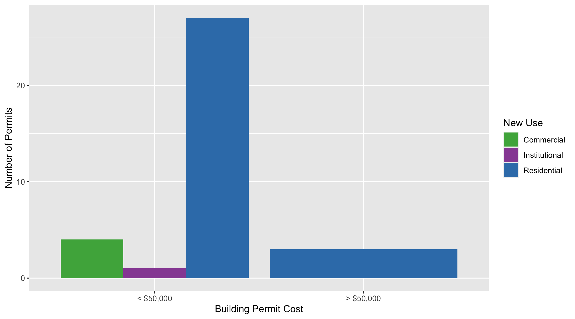
Skinker DeBaliviere Permit Use Breakdown

Slide 24
Skinker DeBaliviere Permit Breakdown
Quarter 1, 2020 | Quarter 1, 2020 | Quarter 1, 2020 | Quarter 1, 2020
Permit Use | Average Cost | # of Permits | Total Value of Permits
Commercial | $12,219 | 4 | $48,876
Industrial | $0 | 0 | $0
Institutional | $10,000 | 1 | $10,000
Residential | $18,429 | 30 | $552,867
Total | $40,648 | 35 | $611,743
Quarter 1, 2019 | Quarter 1, 2019 | Quarter 1, 2019 | Quarter 1, 2019
Permit Use | Average Cost | # of Permits | Total Value of Permits
Commercial | $0 | 0 | $0
Industrial | $0 | 0 | $0
Institutional | $70,000 | 1 | $70,000
Residential | $15,444 | 16 | $247,104
Total | $85,444 | 17 | $317,104

Slide 25
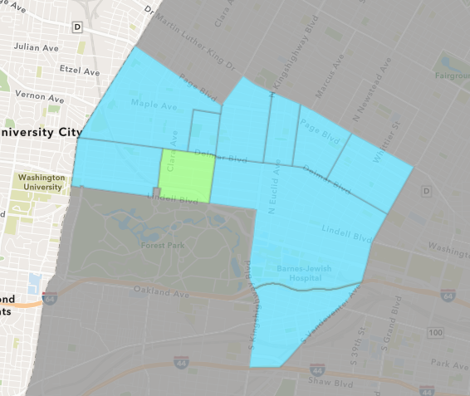
DeBaliviere Place
Quarter 1 , 2020 Neighborhood Cost Breakdown
Sum of Permits: $18,253,606
Mean: $2,028,178
Median: $22,000
Range: $2,500 - $18,000,000

Slide 26
DeBaliviere Place: Summary Notes
9 building permits in Quarter 1, 2020
-30.77% change compared to Quarter 1, 2019 (13 total building permits)
$2,028,178: Average building permit cost in Quarter 1, 2020
5989.70% change compared to Quarter 1, 2019 ($33,305)

Slide 27
DeBaliviere Place: Summary Notes
8 residential permits in Quarter 1, 2020
-33.33% change compared to Quarter 1, 2019 (12 total building permits)
$2,280,701: Average residential building permit cost in Quarter 1, 2020
6370.59% change compared to Quarter 1, 2019 ($35,247)
0 industrial permits in Quarter 1, 2020
0.00% change compared to Quarter 1, 2019 (0 total building permits)
$0: Average industrial building permit cost in Quarter 1, 2020
0.00% change compared to Quarter 1, 2019 ($0)

Slide 28
DeBaliviere Place: Summary Notes
0 commercial permits in Quarter 1, 2020
-100.00% change compared to Quarter 1, 2019 (1 total building permits)
$0: Average commercial building permit cost in Quarter 1, 2020
-100.00% change compared to Quarter 1, 2019 ($10,000)
1 residential permits in Quarter 1, 2020
Infinite change compared to Quarter 1, 2019 (0 total building permits)
$8,000: Average institutional building permit cost in Quarter 1, 2020
Infinite change compared to Quarter 1, 2019 ($0)

Slide 29
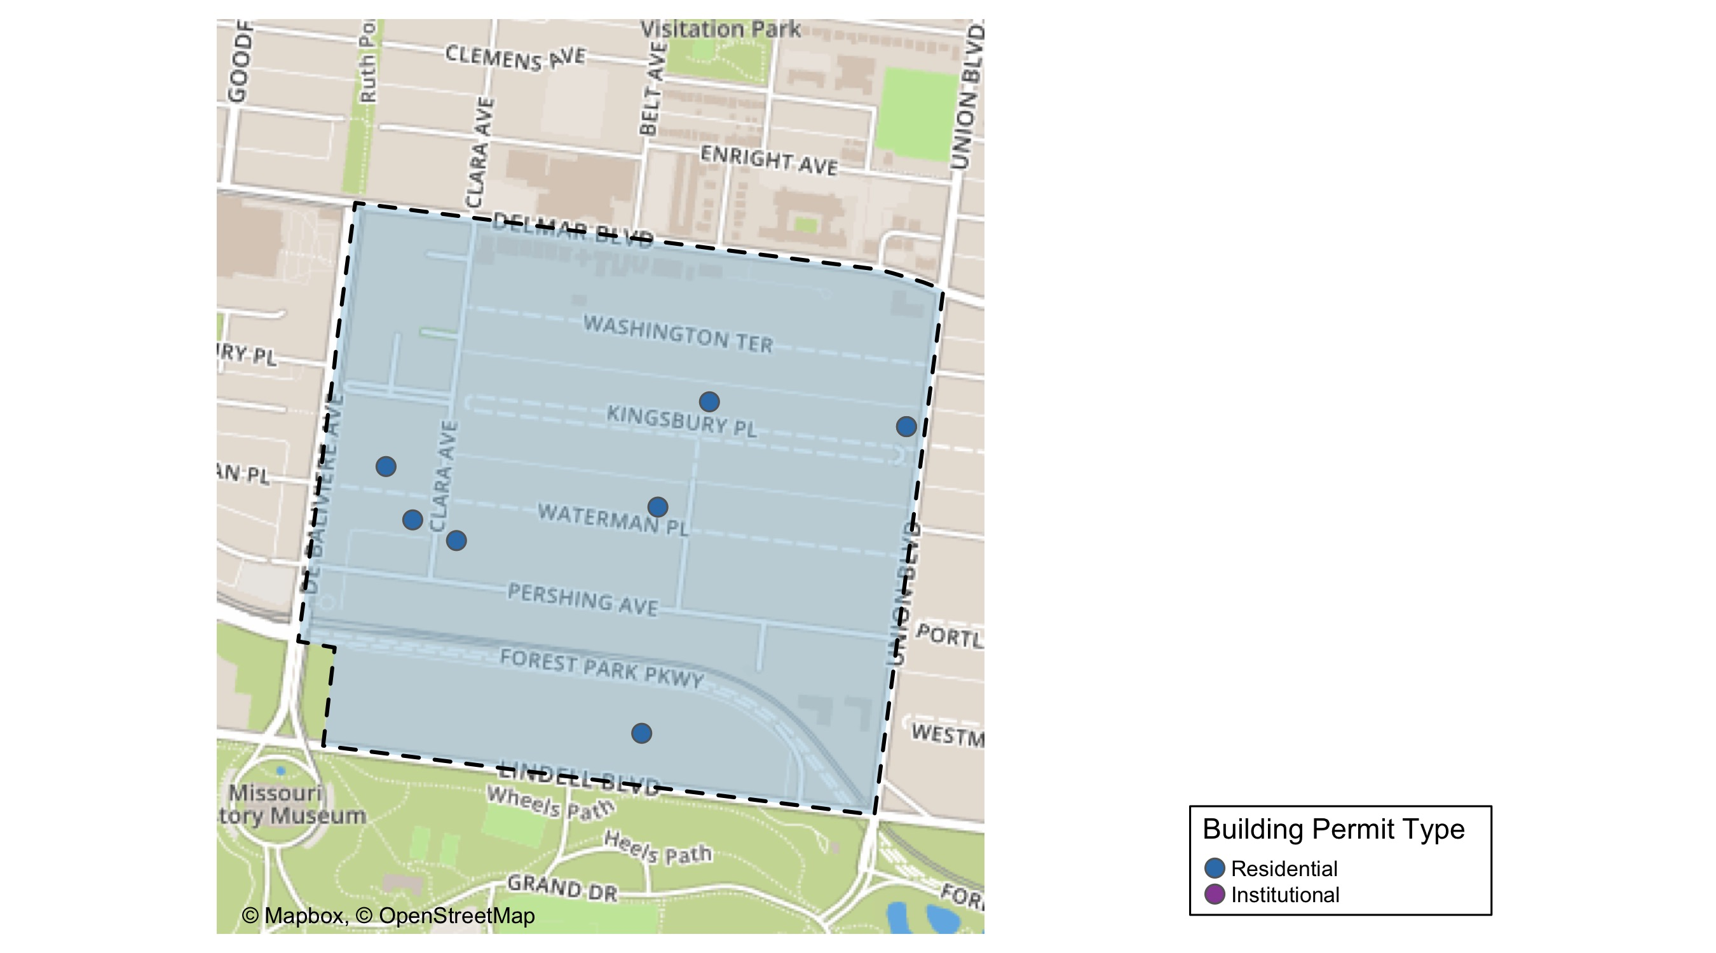
DeBaliviere Place

Slide 30
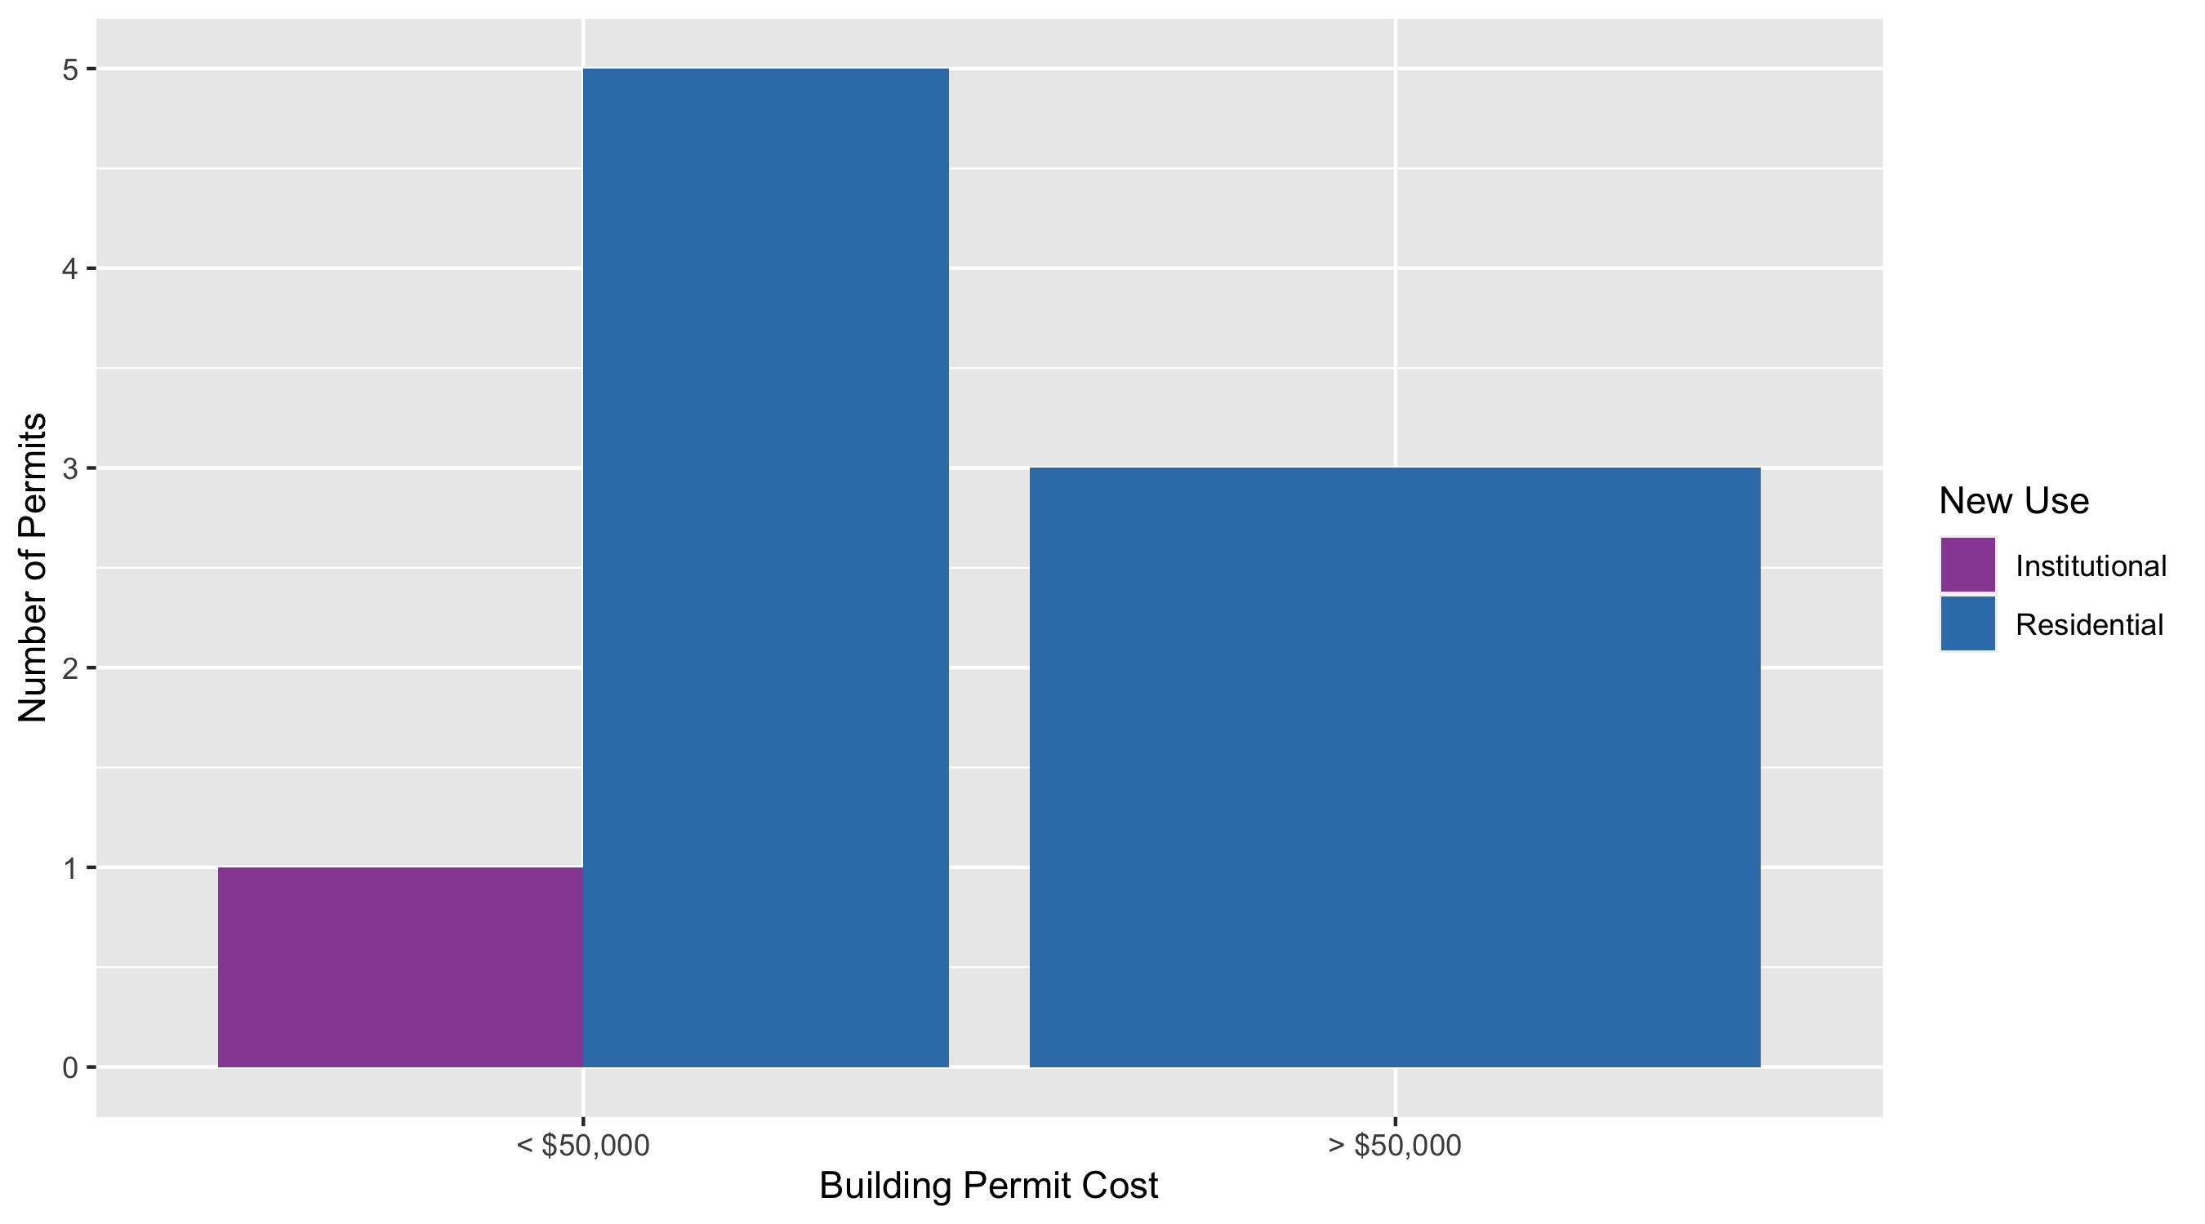
DeBaliviere Place Permit Use Breakdown

Slide 31
DeBaliviere Place Permit Breakdown
Quarter 1, 2020 | Quarter 1, 2020 | Quarter 1, 2020 | Quarter 1, 2020
Permit Use | Average Cost | # of Permits | Total Value of Permits
Commercial | $0 | 0 | $0
Industrial | $0 | 0 | $0
Institutional | $8,000 | 1 | $8,000
Residential | $2,280,701 | 8 | $18,245,606
Total | $2,288,701 | 9 | $18,253,606
Quarter 1, 2019 | Quarter 1, 2019 | Quarter 1, 2019 | Quarter 1, 2019
Permit Use | Average Cost | # of Permits | Total Value of Permits
Commercial | $10,000 | 1 | $10,000
Industrial | $0 | 0 | $0
Institutional | $0 | 0 | $0
Residential | $35,247 | 12 | $422,966
Total | $45,247 | 13 | $432,966

Slide 32
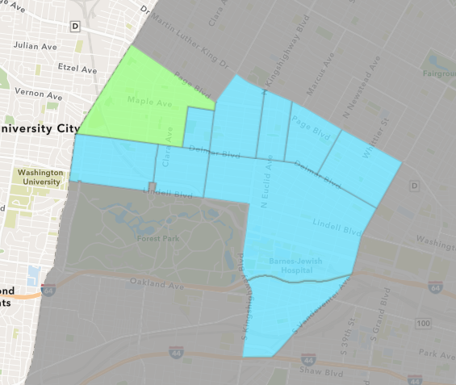
West End
Quarter 1 , 2020 Neighborhood Cost Breakdown
Sum of Permits: $894,796
Mean: $38,904
Median: $9,350
Range: $1,000 - $375,000

Slide 33
West End: Summary Notes
23 building permits in Quarter 1, 2020
155.56% change compared to Quarter 1, 2019 (9 total building permits)
$38,904: Average building permit cost in Quarter 1, 2020
-83.35% change compared to Quarter 1, 2019 ($233,633)

Slide 34
West End: Summary Notes
17 residential permits in Quarter 1, 2020
750.00% change compared to Quarter 1, 2019 (2 total building permits)
$26,426: Average residential building permit cost in Quarter 1, 2020
32.13% change compared to Quarter 1, 2019 ($20,000)
0 industrial permits in Quarter 1, 2020
0.00% change compared to Quarter 1, 2019 (0 total building permits)
$0: Average industrial building permit cost in Quarter 1, 2020
0.00% change compared to Quarter 1, 2019 ($0)

Slide 35
West End: Summary Notes
5 commercial permits in Quarter 1, 2020
-16.67% change compared to Quarter 1, 2019 (6 total building permits)
$85,510: Average commercial building permit cost in Quarter 1, 2020
-69.45% change compared to Quarter 1, 2019 ($279,883)
1 residential permits in Quarter 1, 2020
0.00% change compared to Quarter 1, 2019 (1 total building permits)
$18,000: Average institutional building permit cost in Quarter 1, 2020
-95.31% change compared to Quarter 1, 2019 ($0)

Slide 36
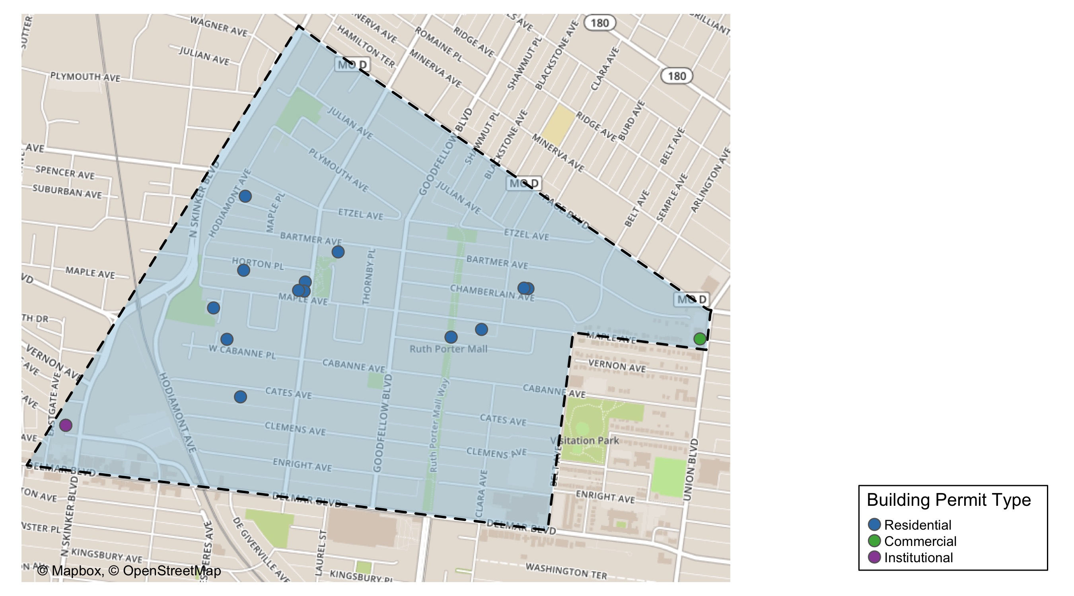
West End

Slide 37
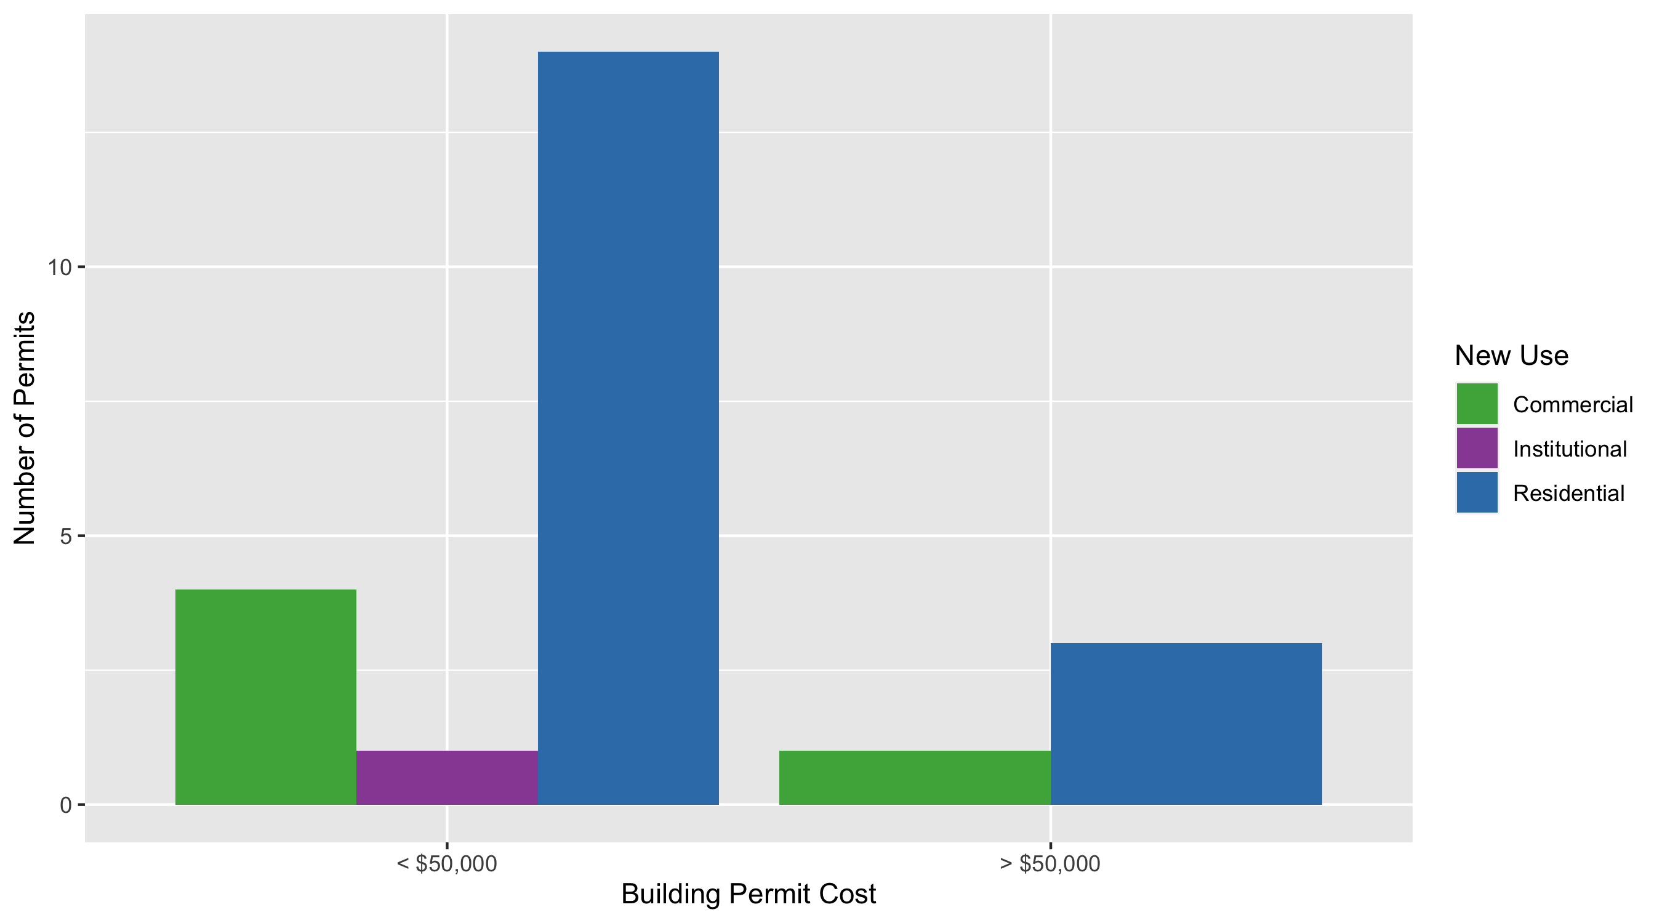
West End Permit Use Breakdown

Slide 38
West End Permit Breakdown
Quarter 1, 2020 | Quarter 1, 2020 | Quarter 1, 2020 | Quarter 1, 2020
Permit Use | Average Cost | # of Permits | Total Value of Permits
Commercial | $85,510 | 5 | $427,550
Industrial | $0 | 0 | $0
Institutional | $18,000 | 1 | $18,000
Residential | $26,426 | 17 | $449,246
Total | $129,936 | 23 | $894,796
Quarter 1, 2019 | Quarter 1, 2019 | Quarter 1, 2019 | Quarter 1, 2019
Permit Use | Average Cost | # of Permits | Total Value of Permits
Commercial | $279,883 | 6 | $1,679,300
Industrial | $0 | 0 | $0
Institutional | $383,400 | 1 | $383,400
Residential | $20,000 | 2 | $40,000
Total | $683,283 | 9 | $2,102,700

Slide 39
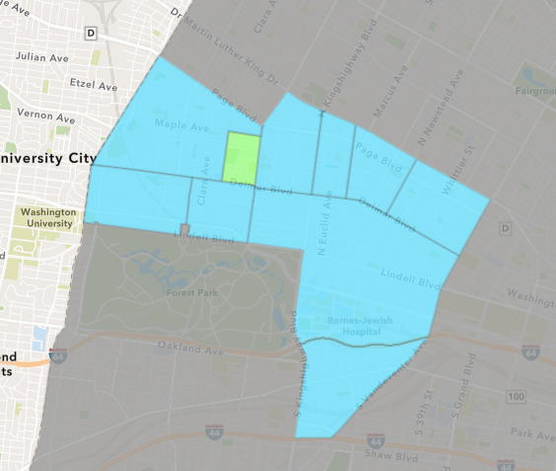
Visitation Park
Quarter 1 , 2020 Neighborhood Cost Breakdown
Sum of Permits: $14,000
Mean: $14,000
Median: $14,000
Range: $14,000 - $14,000

Slide 40
Visitation Park: Summary Notes
1 building permits in Quarter 1, 2020
Infinite change compared to Quarter 1, 2019 (0 total building permits)
$14,000: Average building permit cost in Quarter 1, 2020
Infinite change compared to Quarter 1, 2019 ($0)

Slide 41
Visitation Park: Summary Notes
1 residential permits in Quarter 1, 2020
Infinite change compared to Quarter 1, 2019 (0 total building permits)
$14,000: Average residential building permit cost in Quarter 1, 2020
Infinite change compared to Quarter 1, 2019 ($0)
0 industrial permits in Quarter 1, 2020
0.00% change compared to Quarter 1, 2019 (0 total building permits)
$0: Average industrial building permit cost in Quarter 1, 2020
0.00% change compared to Quarter 1, 2019 ($0)

Slide 42
Visitation Park: Summary Notes
0 commercial permits in Quarter 1, 2020
0.00% change compared to Quarter 1, 2019 (0 total building permits)
$0: Average commercial building permit cost in Quarter 1, 2020
0.00% change compared to Quarter 1, 2019 ($0)
0 residential permits in Quarter 1, 2020
0.00% change compared to Quarter 1, 2019 (0 total building permits)
$0: Average institutional building permit cost in Quarter 1, 2020
0.00% change compared to Quarter 1, 2019 ($0)

Slide 43
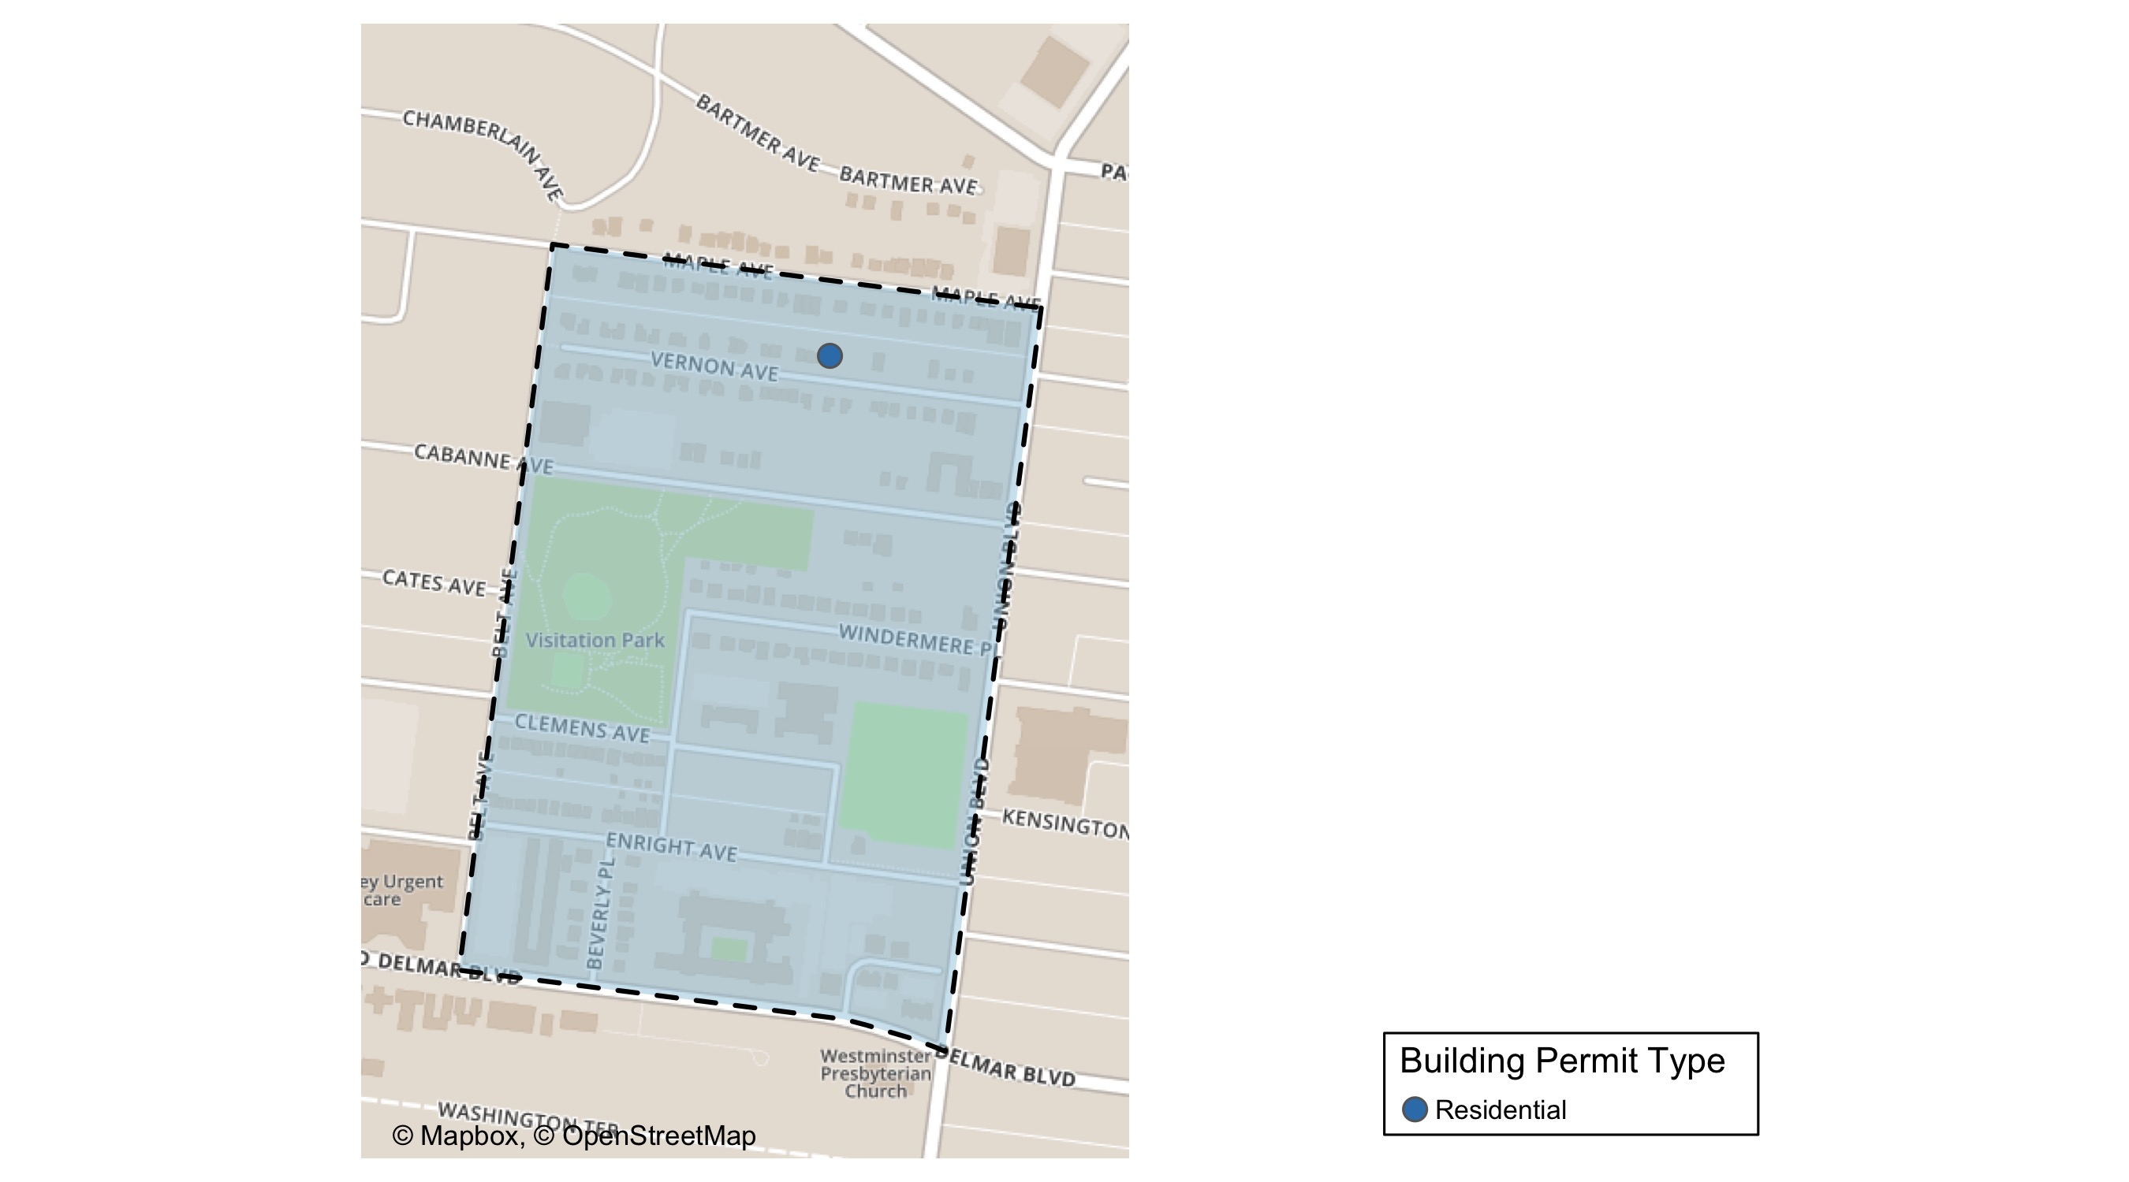
Visitation Park

Slide 44
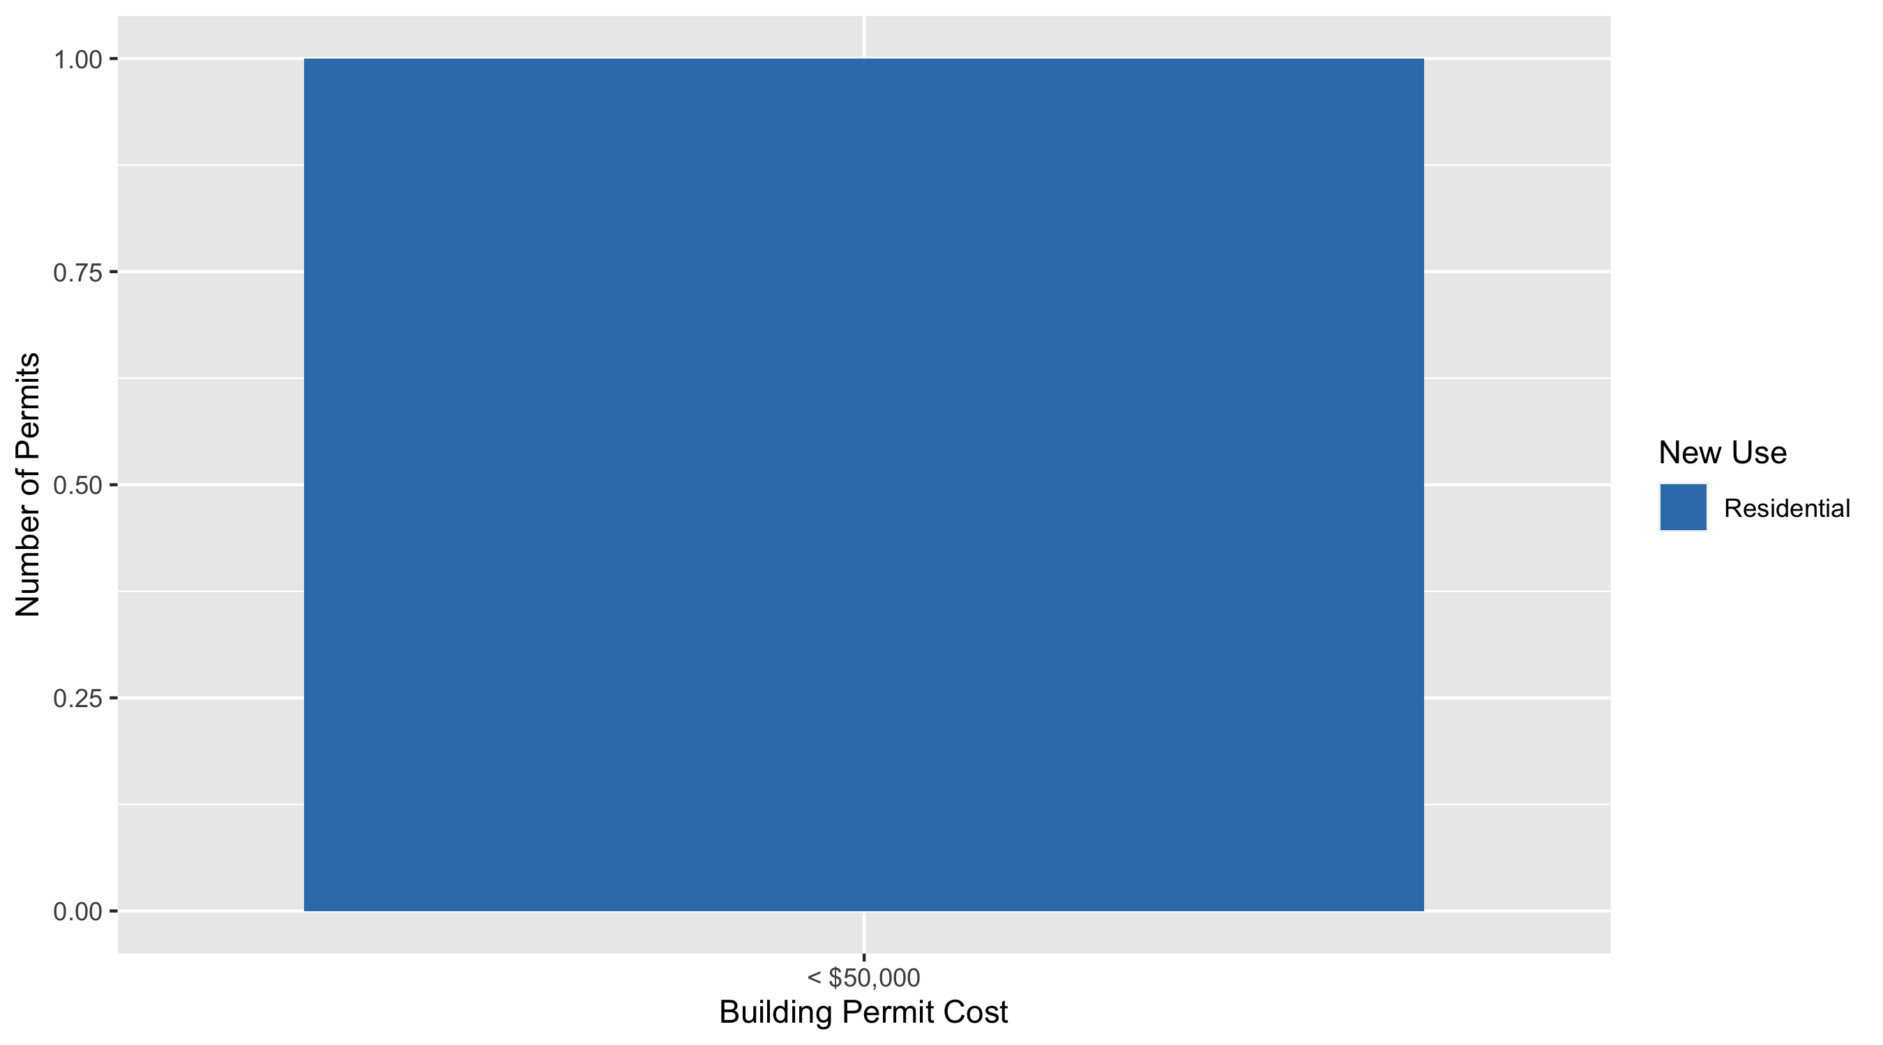
Visitation Park Permit Use Breakdown

Slide 45
Visitation Park Permit Breakdown
Quarter 1, 2020 | Quarter 1, 2020 | Quarter 1, 2020 | Quarter 1, 2020
Permit Use | Average Cost | # of Permits | Total Value of Permits
Commercial | $0 | 0 | $0
Industrial | $0 | 0 | $0
Institutional | $0 | 0 | $0
Residential | $14,000 | 1 | $14,000
Total | $14,000 | 1 | $14,000
Quarter 1, 2019 | Quarter 1, 2019 | Quarter 1, 2019 | Quarter 1, 2019
Permit Use | Average Cost | # of Permits | Total Value of Permits
Commercial | $0 | 0 | $0
Industrial | $0 | 0 | $0
Institutional | $0 | 0 | $0
Residential | $0 | 0 | $0
Total | $0 | 0 | $0

Slide 46
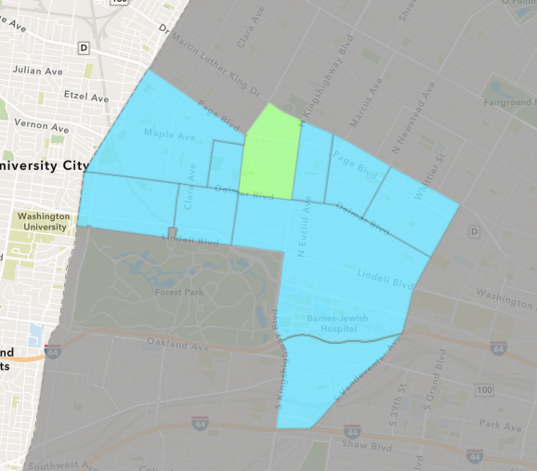
Academy
Quarter 1 , 2020 Neighborhood Cost Breakdown
Sum of Permits: $874,950
Mean: $87,495
Median: $77,500
Range: $1,500 - $200,000

Slide 47
Academy: Summary Notes
10 building permits in Quarter 1, 2020
42.86% change compared to Quarter 1, 2019 (7 total building permits)
$87,495: Average building permit cost in Quarter 1, 2020
12.03% change compared to Quarter 1, 2019 ($78,101)

Slide 48
Academy: Summary Notes
9 residential permits in Quarter 1, 2020
28.57% change compared to Quarter 1, 2019 (7 total building permits)
$86,106: Average residential building permit cost in Quarter 1, 2020
10.25% change compared to Quarter 1, 2019 ($78,101)
0 industrial permits in Quarter 1, 2020
0.00% change compared to Quarter 1, 2019 (0 total building permits)
$0: Average industrial building permit cost in Quarter 1, 2020
0.00% change compared to Quarter 1, 2019 ($0)

Slide 49
Academy: Summary Notes
0 commercial permits in Quarter 1, 2020
0.00% change compared to Quarter 1, 2019 (0 total building permits)
$0: Average commercial building permit cost in Quarter 1, 2020
0.00% change compared to Quarter 1, 2019 ($0)
1 residential permits in Quarter 1, 2020
Infinite change compared to Quarter 1, 2019 (0 total building permits)
$100,000: Average institutional building permit cost in Quarter 1, 2020
Infinite change compared to Quarter 1, 2019 ($0)

Slide 50
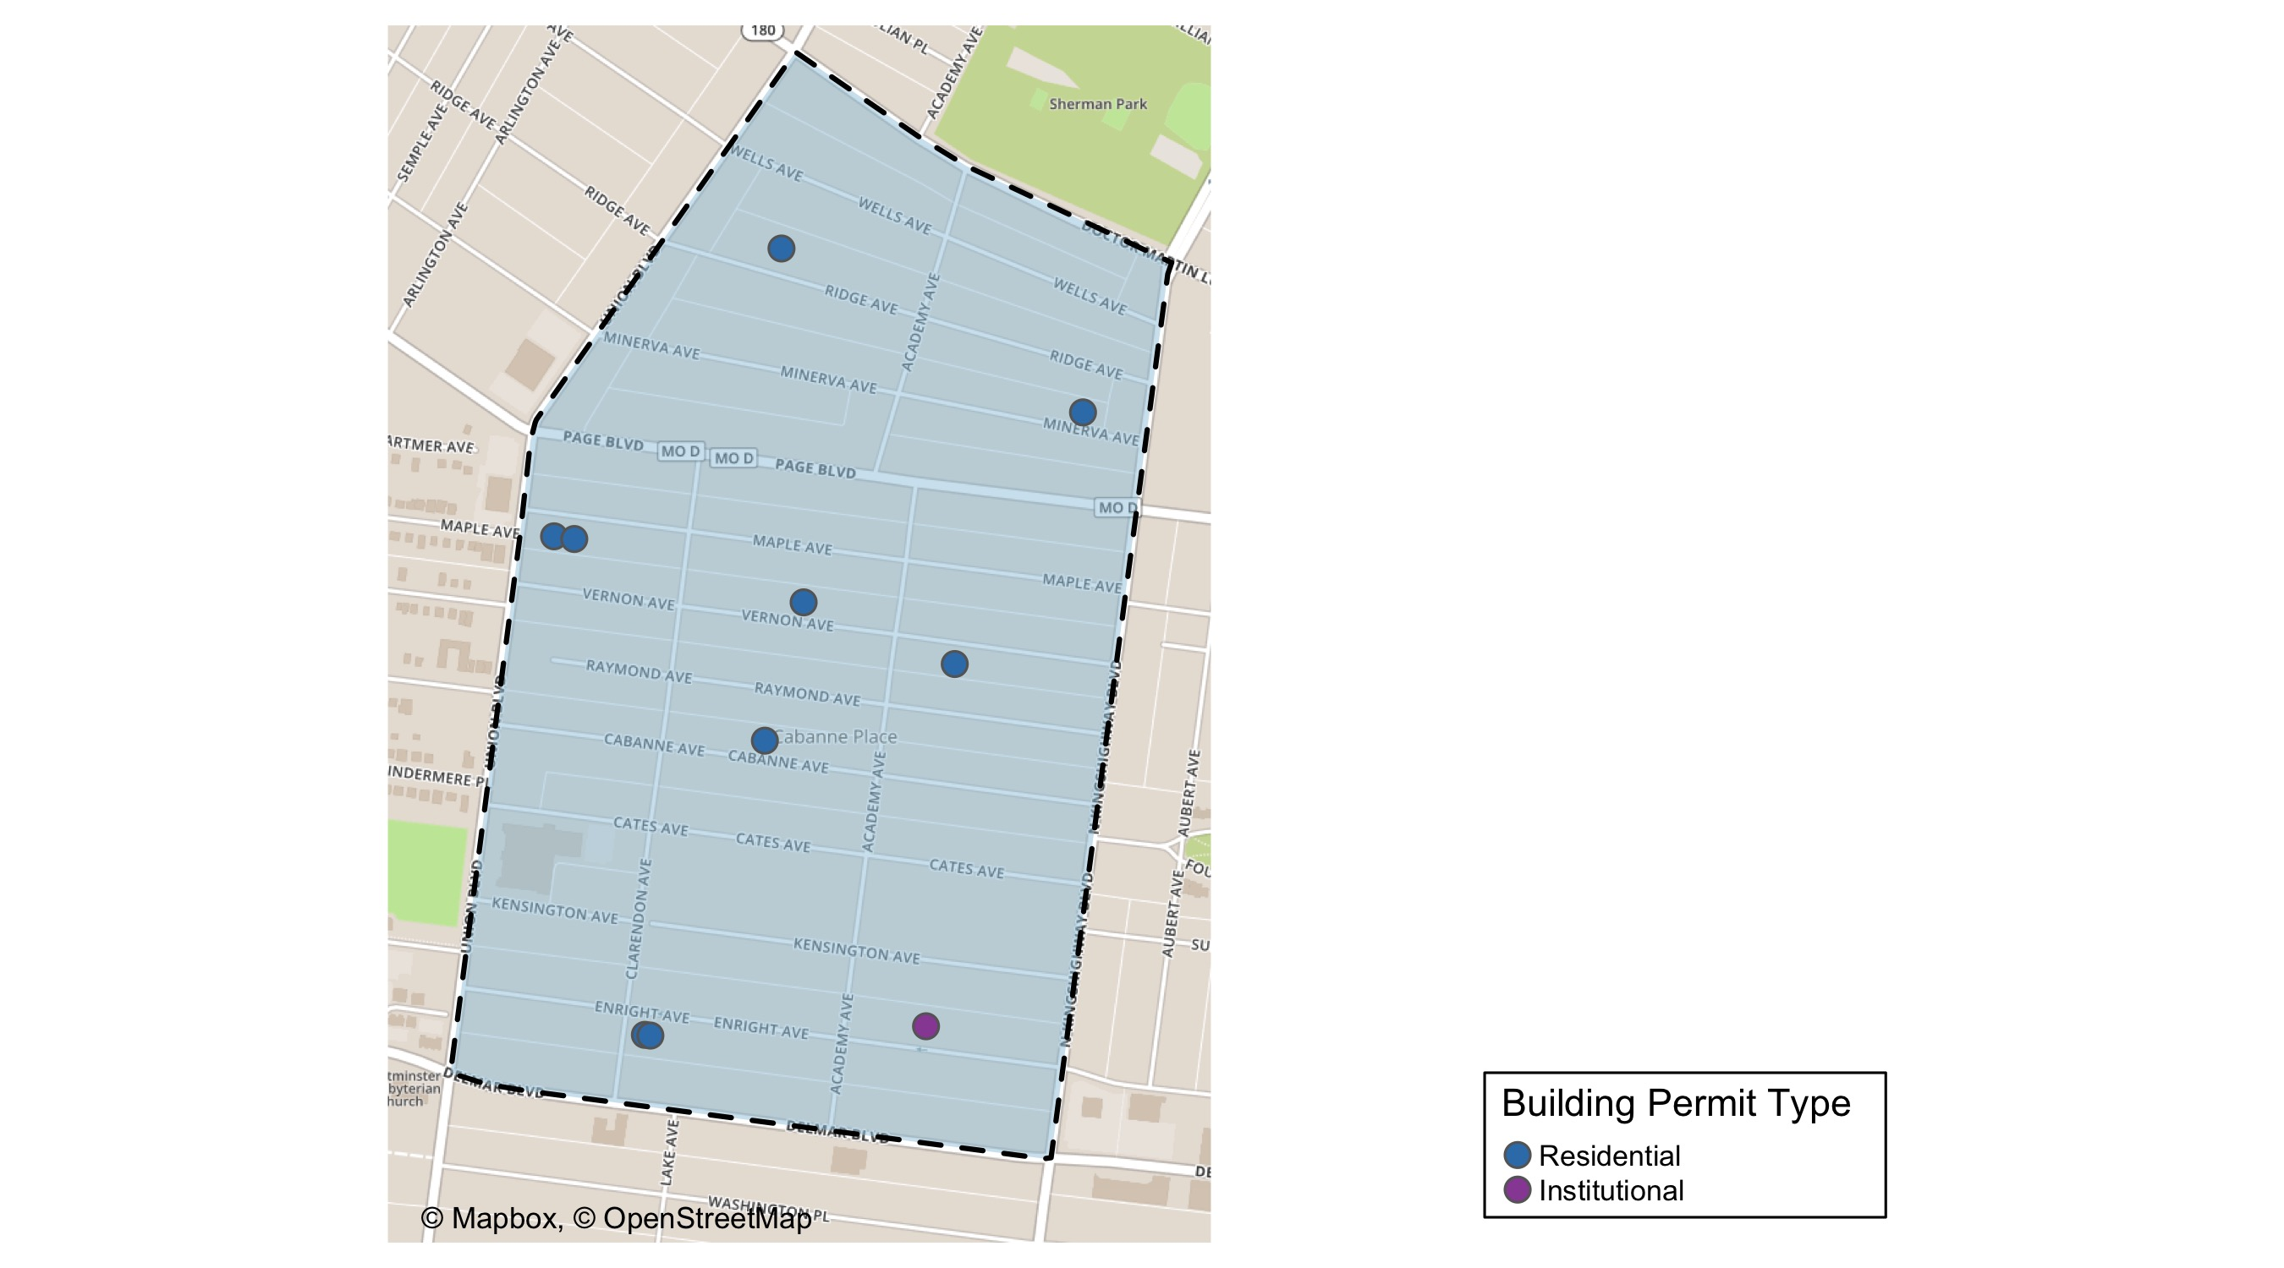
Academy

Slide 51
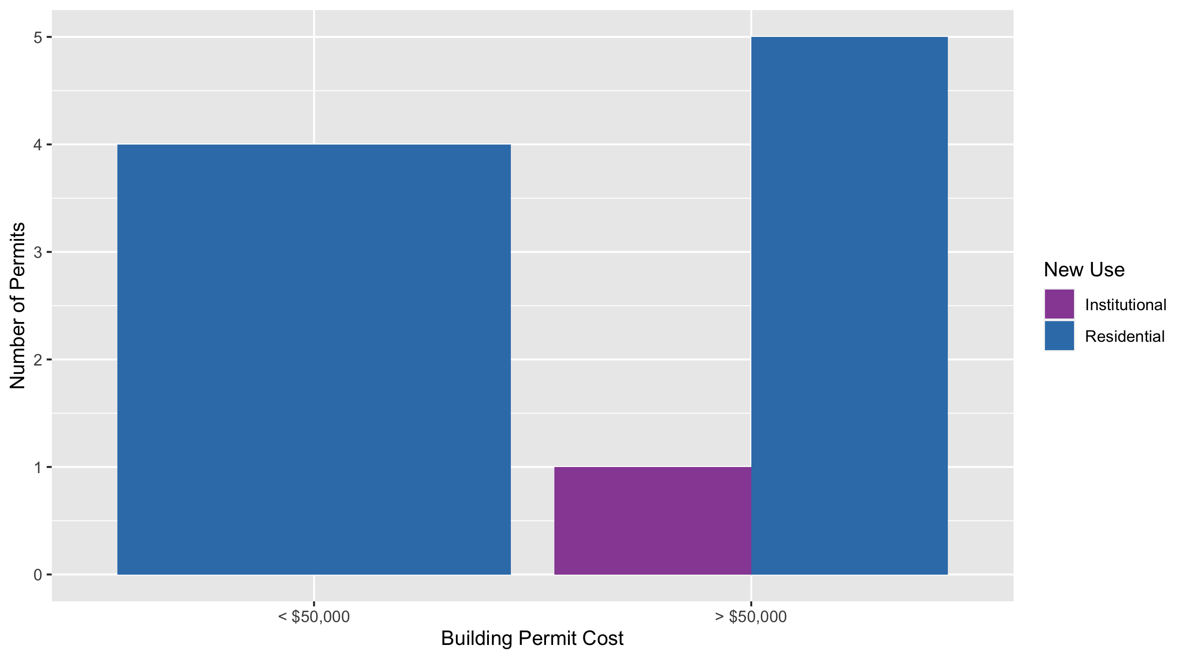
Academy Permit Use Breakdown

Slide 52
Academy Permit Breakdown
Quarter 1, 2020 | Quarter 1, 2020 | Quarter 1, 2020 | Quarter 1, 2020
Permit Use | Average Cost | # of Permits | Total Value of Permits
Commercial | $0 | 0 | $0
Industrial | $0 | 0 | $0
Institutional | $100,000 | 1 | $100,000
Residential | $86,106 | 9 | $774,950
Total | $186,106 | 10 | $874,950
Quarter 1, 2019 | Quarter 1, 2019 | Quarter 1, 2019 | Quarter 1, 2019
Permit Use | Average Cost | # of Permits | Total Value of Permits
Commercial | $0 | 0 | $0
Industrial | $0 | 0 | $0
Institutional | $0 | 0 | $0
Residential | $78,101 | 7 | $546,705
Total | $78,101 | 7 | $546,705

Slide 53
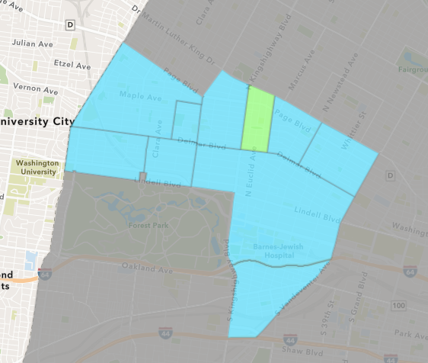
Fountain Park
Quarter 1 , 2020 Neighborhood Cost Breakdown
Sum of Permits: $2,000
Mean: $2,000
Median: $2,000
Range: $2,000 - $2,000

Slide 54
Fountain Park: Summary Notes
1 building permits in Quarter 1, 2020
0.00% change compared to Quarter 1, 2019 (1 total building permits)
$2,000: Average building permit cost in Quarter 1, 2020
300.00% change compared to Quarter 1, 2019 ($500)

Slide 55
Fountain Park: Summary Notes
1 residential permits in Quarter 1, 2020
0.00% change compared to Quarter 1, 2019 (1 total building permits)
$2,000: Average residential building permit cost in Quarter 1, 2020
300.00% change compared to Quarter 1, 2019 ($500)
0 industrial permits in Quarter 1, 2020
0.00% change compared to Quarter 1, 2019 (0 total building permits)
$0: Average industrial building permit cost in Quarter 1, 2020
0.00% change compared to Quarter 1, 2019 ($0)

Slide 56
Fountain Park: Summary Notes
0 commercial permits in Quarter 1, 2020
0.00% change compared to Quarter 1, 2019 (0 total building permits)
$0: Average commercial building permit cost in Quarter 1, 2020
0.00% change compared to Quarter 1, 2019 ($0)
0 residential permits in Quarter 1, 2020
0.00% change compared to Quarter 1, 2019 (0 total building permits)
$0: Average institutional building permit cost in Quarter 1, 2020
0.00% change compared to Quarter 1, 2019 ($0)

Slide 57
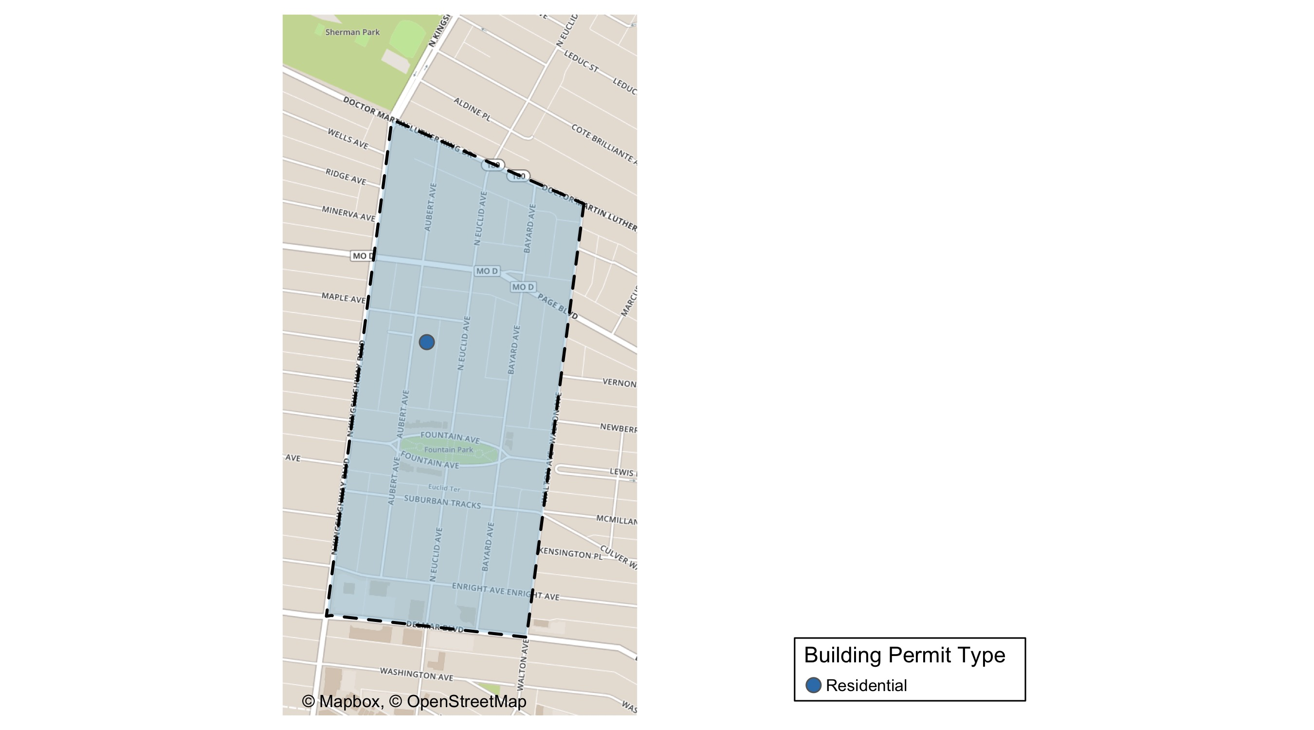
Fountain Park

Slide 58
Fountain Park Permit Use Breakdown

Slide 59
Fountain Park Permit Breakdown
Quarter 1, 2020 | Quarter 1, 2020 | Quarter 1, 2020 | Quarter 1, 2020
Permit Use | Average Cost | # of Permits | Total Value of Permits
Commercial | $0 | 0 | $0
Industrial | $0 | 0 | $0
Institutional | $0 | 0 | $0
Residential | $2,000 | 1 | $2,000
Total | $2,000 | 1 | $2,000
Quarter 1, 2019 | Quarter 1, 2019 | Quarter 1, 2019 | Quarter 1, 2019
Permit Use | Average Cost | # of Permits | Total Value of Permits
Commercial | $0 | 0 | $0
Industrial | $0 | 0 | $0
Institutional | $0 | 0 | $0
Residential | $500 | 1 | $500
Total | $500 | 1 | $500

Slide 60
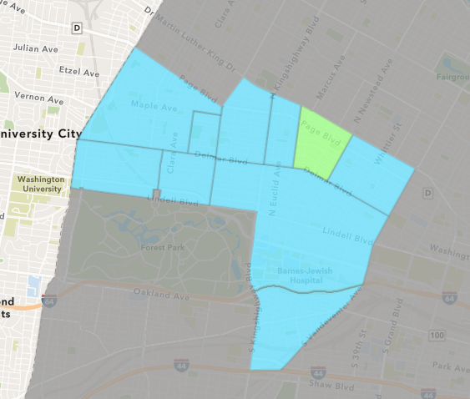
Lewis Place
Quarter 1 , 2020 Neighborhood Cost Breakdown
Sum of Permits: $2,500
Mean: $2,500
Median: $2,500
Range: $2,500 - $2,500

Slide 61
Lewis Place: Summary Notes
1 building permits in Quarter 1, 2020
-80.00% change compared to Quarter 1, 2019 (5 total building permits)
$2,500: Average building permit cost in Quarter 1, 2020
-52.11% change compared to Quarter 1, 2019 ($5,220)

Slide 62
Lewis Place: Summary Notes
1 residential permits in Quarter 1, 2020
-80.00% change compared to Quarter 1, 2019 (5 total building permits)
$2,500: Average residential building permit cost in Quarter 1, 2020
-52.11% change compared to Quarter 1, 2019 ($5,220)
0 industrial permits in Quarter 1, 2020
0.00% change compared to Quarter 1, 2019 (0 total building permits)
$0: Average industrial building permit cost in Quarter 1, 2020
0.00% change compared to Quarter 1, 2019 ($0)

Slide 63
Lewis Place: Summary Notes
0 commercial permits in Quarter 1, 2020
0.00% change compared to Quarter 1, 2019 (0 total building permits)
$0: Average commercial building permit cost in Quarter 1, 2020
0.00% change compared to Quarter 1, 2019 ($0)
0 residential permits in Quarter 1, 2020
0.00% change compared to Quarter 1, 2019 (0 total building permits)
$0: Average institutional building permit cost in Quarter 1, 2020
0.00% change compared to Quarter 1, 2019 ($0)

Slide 64
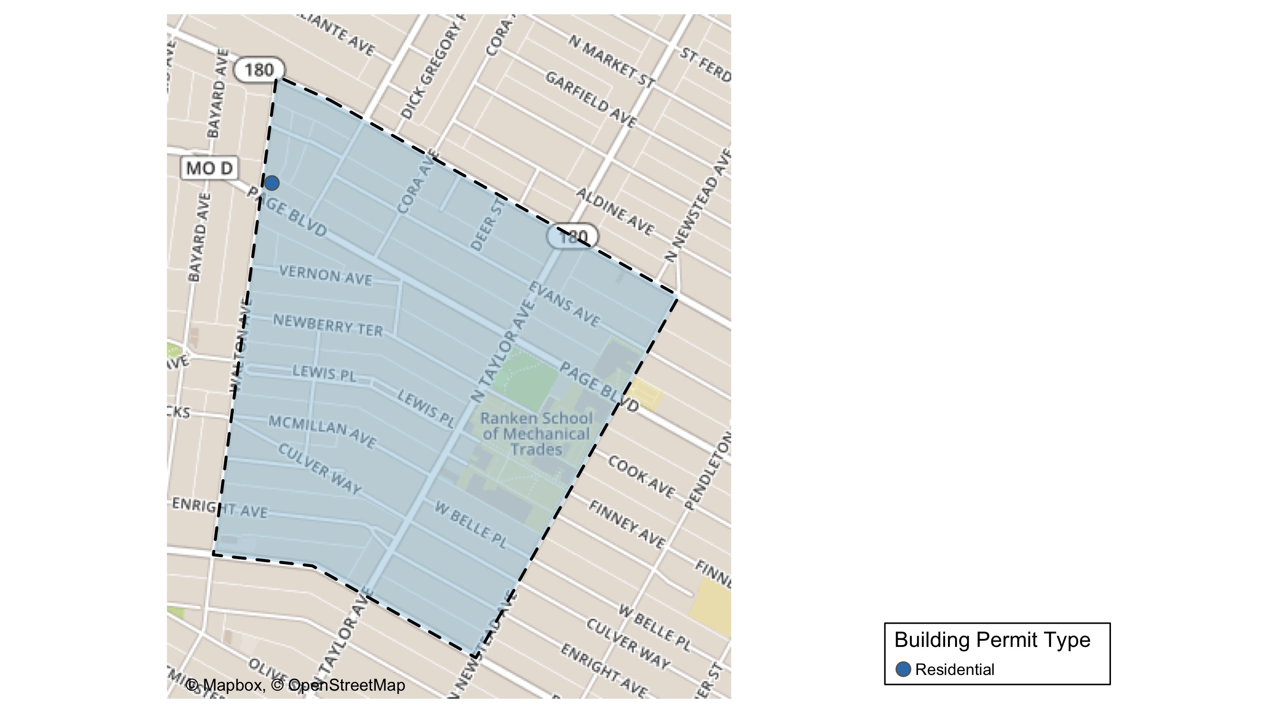
Lewis Place

Slide 65
Lewis Place Permit Use Breakdown

Slide 66
Lewis Place Permit Breakdown
Quarter 1, 2020 | Quarter 1, 2020 | Quarter 1, 2020 | Quarter 1, 2020
Permit Use | Average Cost | # of Permits | Total Value of Permits
Commercial | $0 | 0 | $0
Industrial | $0 | 0 | $0
Institutional | $0 | 0 | $0
Residential | $2,500 | 1 | $2,500
Total | $2,500 | 1 | $2,500
Quarter 1, 2019 | Quarter 1, 2019 | Quarter 1, 2019 | Quarter 1, 2019
Permit Use | Average Cost | # of Permits | Total Value of Permits
Commercial | $0 | 0 | $0
Industrial | $0 | 0 | $0
Institutional | $0 | 0 | $0
Residential | $5,220 | 5 | $26,100
Total | $5,220 | 5 | $26,100

Slide 67
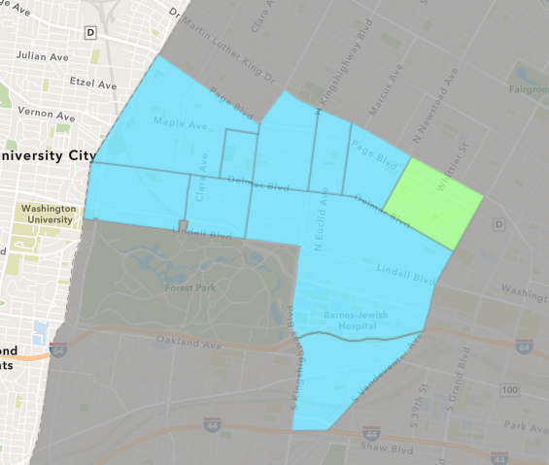
Vandeventer
Quarter 1 , 2020 Neighborhood Cost Breakdown
Sum of Permits: $87,377
Mean: $29,126
Median: $23,646
Range: $8,731 - $55,000

Slide 68
Vandeventer: Summary Notes
3 building permits in Quarter 1, 2020
-62.50% change compared to Quarter 1, 2019 (8 total building permits)
$29,126: Average building permit cost in Quarter 1, 2020
-91.80% change compared to Quarter 1, 2019 ($355,241)

Slide 69
Vandeventer: Summary Notes
2 residential permits in Quarter 1, 2020
-66.67% change compared to Quarter 1, 2019 (6 total building permits)
$79,366: Average residential building permit cost in Quarter 1, 2020
1422.11% change compared to Quarter 1, 2019 ($5,214)
1 industrial permits in Quarter 1, 2020
Infinite change compared to Quarter 1, 2019 (0 total building permits)
$55,000: Average industrial building permit cost in Quarter 1, 2020
Infinite change compared to Quarter 1, 2019 ($0)

Slide 70
Vandeventer: Summary Notes
0 commercial permits in Quarter 1, 2020
-100.00% change compared to Quarter 1, 2019 (1 total building permits)
$0: Average commercial building permit cost in Quarter 1, 2020
-100.00% change compared to Quarter 1, 2019 ($2,746,645)
1 residential permits in Quarter 1, 2020
0.00% change compared to Quarter 1, 2019 (1 total building permits)
$23,646: Average institutional building permit cost in Quarter 1, 2020
-63.05% change compared to Quarter 1, 2019 ($0)

Slide 71
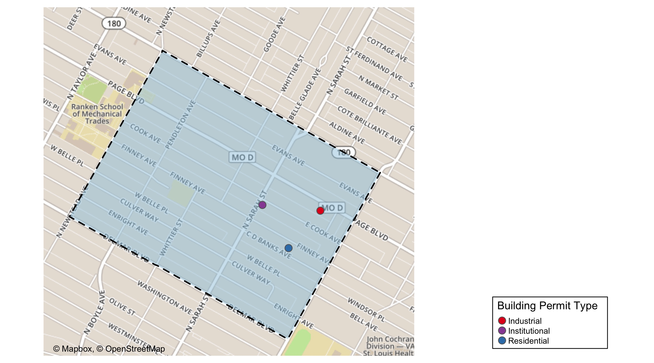
Vandeventer

Slide 72
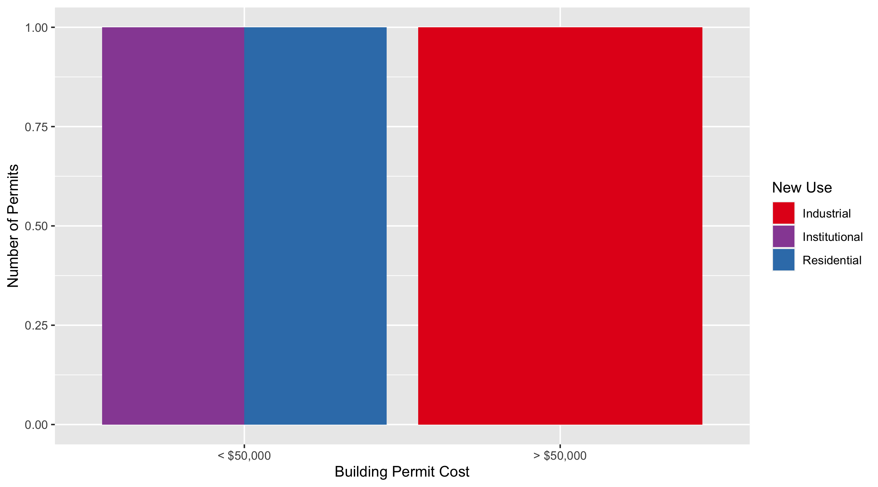
Vandeventer Permit Use Breakdown

Slide 73
Vandeventer Permit Breakdown
Quarter 1, 2020 | Quarter 1, 2020 | Quarter 1, 2020 | Quarter 1, 2020
Permit Use | Average Cost | # of Permits | Total Value of Permits
Commercial | $0 | 0 | $0
Industrial | $55,000 | 1 | $55,000
Institutional | $23,646 | 1 | $23,646
Residential | $8,731 | 1 | $8,731
Total | $87,377 | 3 | $87,377
Quarter 1, 2019 | Quarter 1, 2019 | Quarter 1, 2019 | Quarter 1, 2019
Permit Use | Average Cost | # of Permits | Total Value of Permits
Commercial | $2,746,645 | 1 | $2,746,645
Industrial | $0 | 0 | $0
Institutional | $64,000 | 1 | $64,000
Residential | $5,214 | 6 | $31,285
Total | $2,815,859 | 8 | $2,841,930

Slide 74
Additional Notes
Data retreived from https://www.stlouis-mo.gov/data/
Building permits with a cost of $0 were dropped
Building permits that were cancelled were dropped
Infinite change indicates 0 permits in the current or previous time period/comparison month so there was a overall increase or decrease

